Slide 1
Complete LSM Pipeline
With reasons for doing things

Slide 2
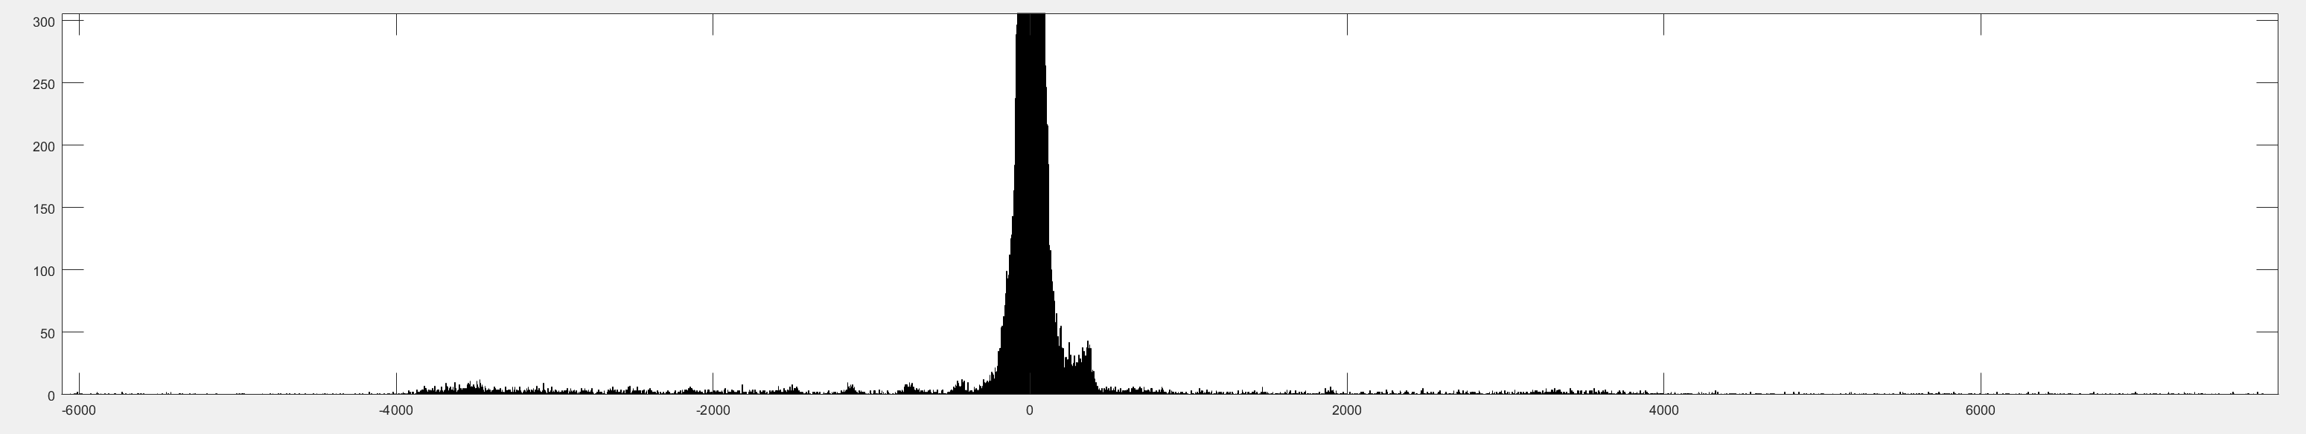

Slide 3
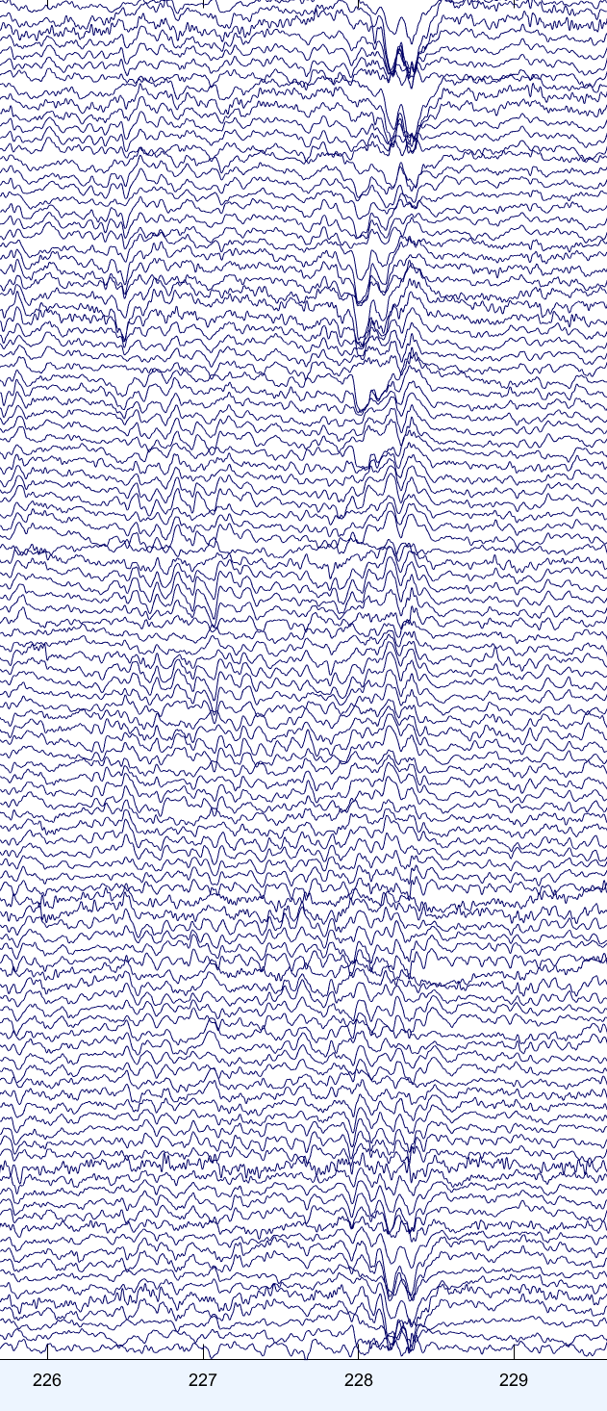
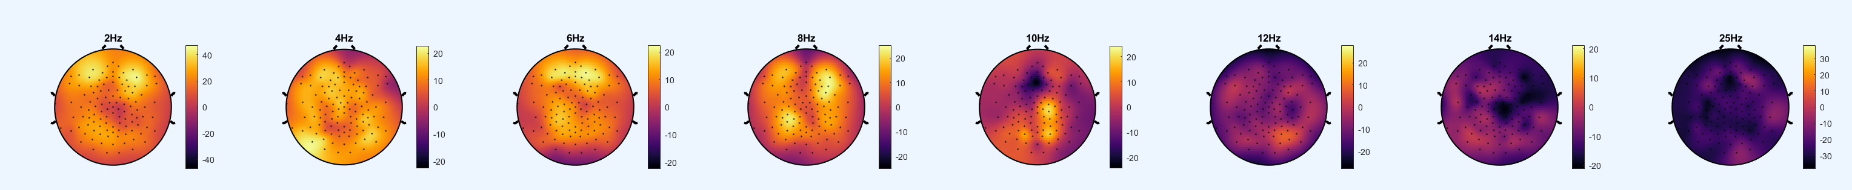

Slide 4
A: Organize the data
Organize data into folder structure
Convert from .eeg to .set
Raw SET files
B: Light filtering
Low-pass filter <40Hz
Notch filter 50Hz + harmonics
High-pass filter >.25Hz
LightFiltering
Downsample 125 Hz
Scoring
Automatic noise selection
Manual noise selection
Cuts
C: Cleaning
Crop data start /stop; remove bad channels
Reference to average
High-pass filter <30 Hz
Low-pass filter >1 Hz
Calculate runica ICA components
HeavyFiltering
D: ICA
Manually select blinks & heartbeat
Deblinked
Interpolate bad segments
Interpolate bad channels
Interpolated
E: Interpolate

Slide 5
A: Organize the Data
How the data is saved in such a way that a computer can find correct files, and how to handle mistakes.

Slide 6


Place raw data in correct folder structure
Every final folder should only contain 1 file of every file type. This folder will save the BrainAmp stuff and the most basic .set file
Convert all files from BrainVision format to EEGLAB’s “.set”
Cut data that was accidentally recorded for too long, especially if the net was removed leaving massive artefacts at the end, or if more than one recording was saved in the same file
Chop up all the RRT recordings into Fixation, Oddball and Standing and Questionnaire
Indicates whether performed by human or computer

Slide 7
Data Structure of Raw Folders
Raw
Background Questionnaires
Biocalibration
Fixation
Game
LAT
Logs
Match2Sample
Music
MWT
Oddball
PVT
Sleep
SpFT
Standing
TV
Debriefing
Lifestyle
Screening
Questionnaire
Demographics
Disruption
Drinking
Eating 1
Eating 2
Handedness
Health
Lifestyle 1
Lifestyle 2
Pain
Sleep
MCTQ
PSQI
Sleep
Wake
Baseline
EEG
BLPre …
EEG
EyeTracking
Questionnaire
Baseline …
Behavior
EEG
EyeTracking
Questionnaire
BLBeam …
Behavior
EEG
EyeTracking
Questionnaire
Pictures
Baseline
Behavior
EEG
Eyetracking
Questionnaire
Baseline …
Behavior
EEG
Eyetracking
Questionnaire
Main
Behavior
EEG
Eyetracking
Questionnaire
BaselinePost…
Behavior
EEG
EyeTracking
BaselineBeam
Behavior
EEG
Eyetracking
Questionnaire
Baseline
BaselineWeek
MainWeek
NightPost
NightPre
Actigraphy
EEG
Questionnaire
Actigraphy
BL-1 …
EEG
Questionnaire
Actigraphy
EEG
Questionnaire
Baseline …
Behavior
EEG
Eyetracking
Questionnaire
Recordings
Blpost …
EEG
TV1…
EEG
Note: A template folder saves this structure, then its copied for each participant, and the appropriate data is put only in the final folder of each folder path (e.g. P05>LAT>BaselinePost>EEG). Scripts then “hunt” for the data by looking at these path ends, and uses the sequence of folders in the path to determine what each file corresponds to. This allows poor researchers to name things haphazardly (e.g. “P05BLpostrealLAT.eeg”) while collecting data, and the program to automatically find the correct files based on location, without relying on the file name (ending up as “P05_LAT_BaselinePost.set”).

Slide 8
B: Light Filtering
How to process the data just enough so you can see what it looks like

Slide 9
Notch filter 50Hz and harmonics
Low-Pass filter the data at 40 Hz
Resample the data from 1000Hz to 256Hz
High-Pass filter the data at 0.5 Hz
Save all files from same task in same folder (away from the Raw, to avoid screwing up the main copy), using folder chain as new filename (So file in P05>LAT>MainPost>EEG becomes “P05_LAT_MainPost.set”)

Slide 10
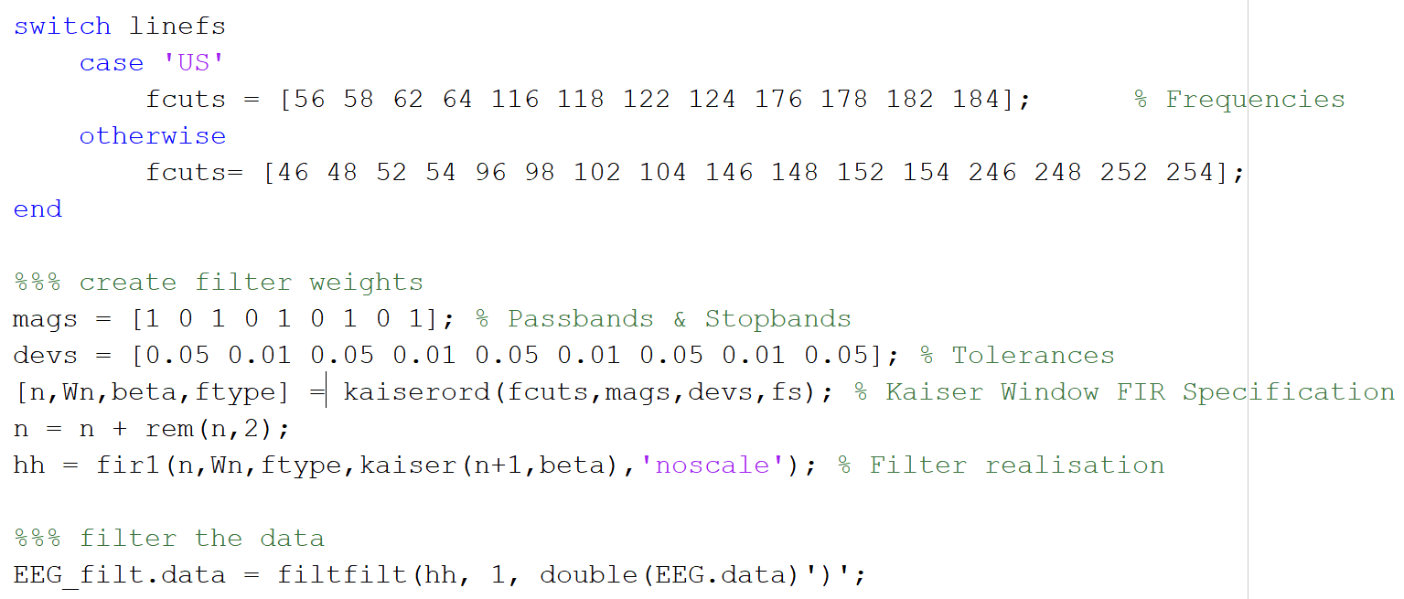
Fancy notch filter for line noise + harmonics

Slide 11
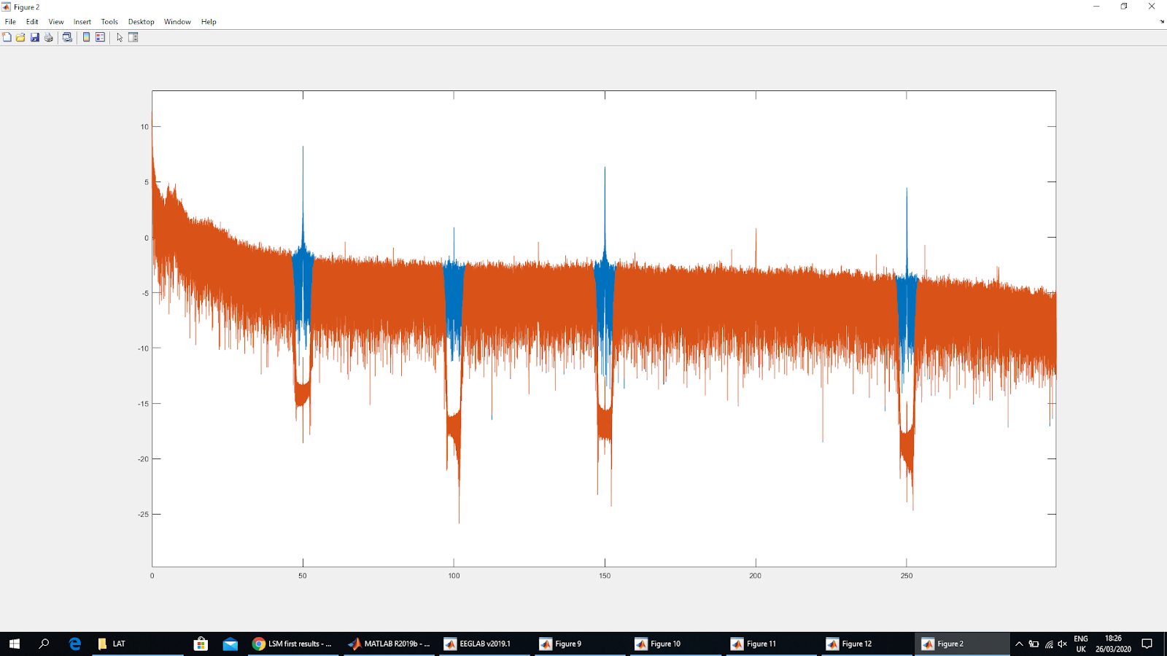
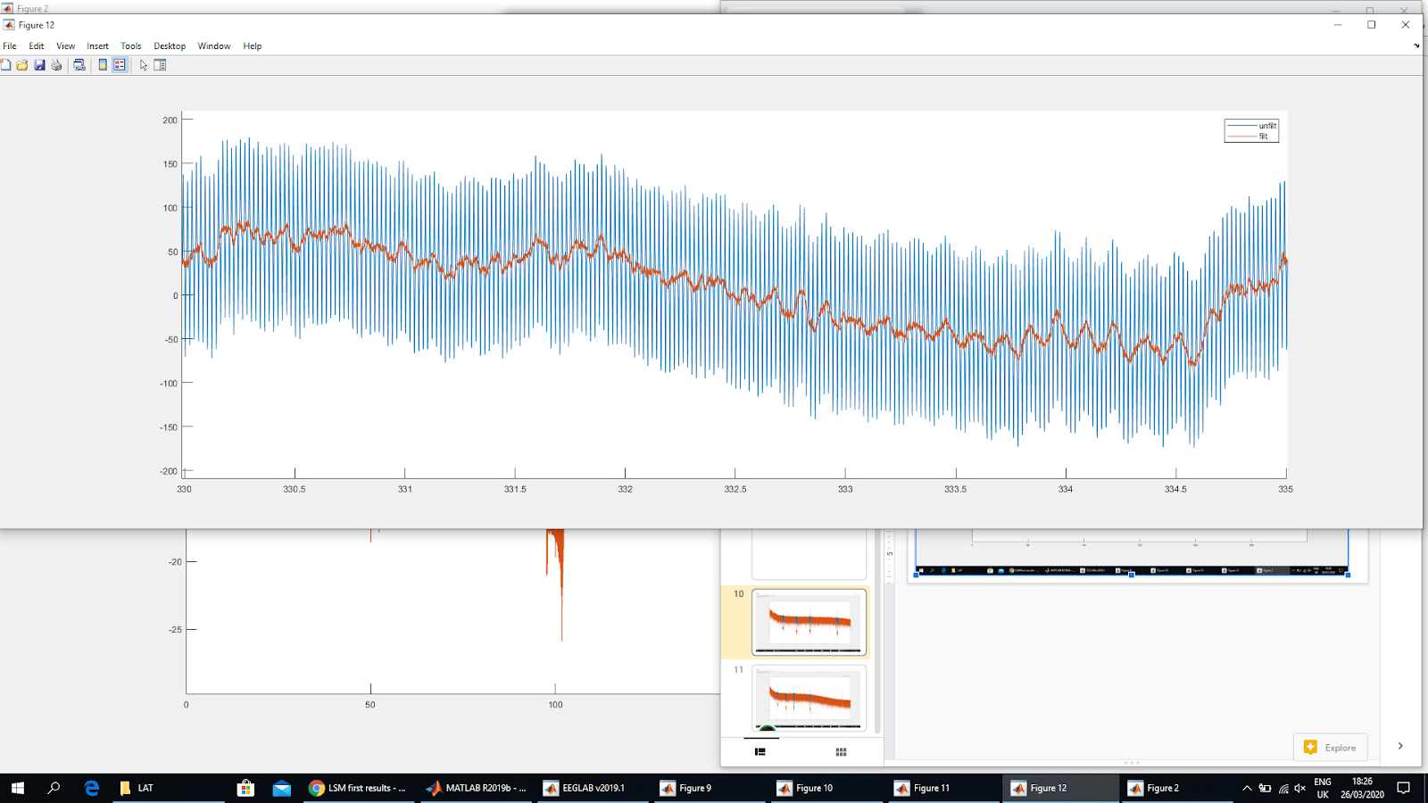
Frequency domain
Time domain

Slide 12
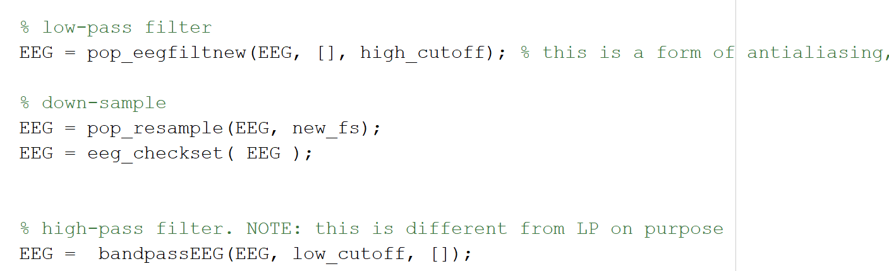
Filtering + downsampling
Note: downsampling is done after LP filtering, because people are worried about aliasing (not really a problem when high cutoff is << than Nyquist). Best to do HP filtering after though, because it’s a lot slower.

Slide 13
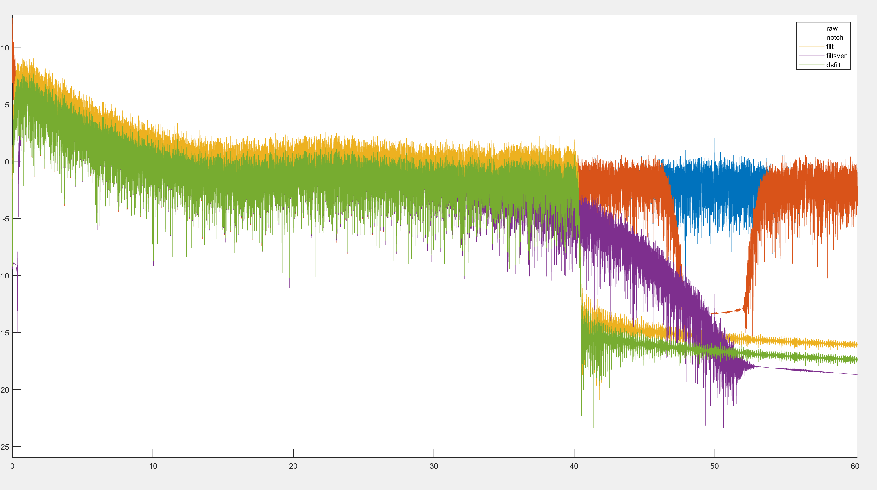
Note: EEGlab default filters did a good job of sharply cutting off the frequencies at 40Hz, without any noticeable ringing effects. The green relative to yellow has been additionally downsampled
EEGLAB
Sven
Raw/Notch

Slide 14
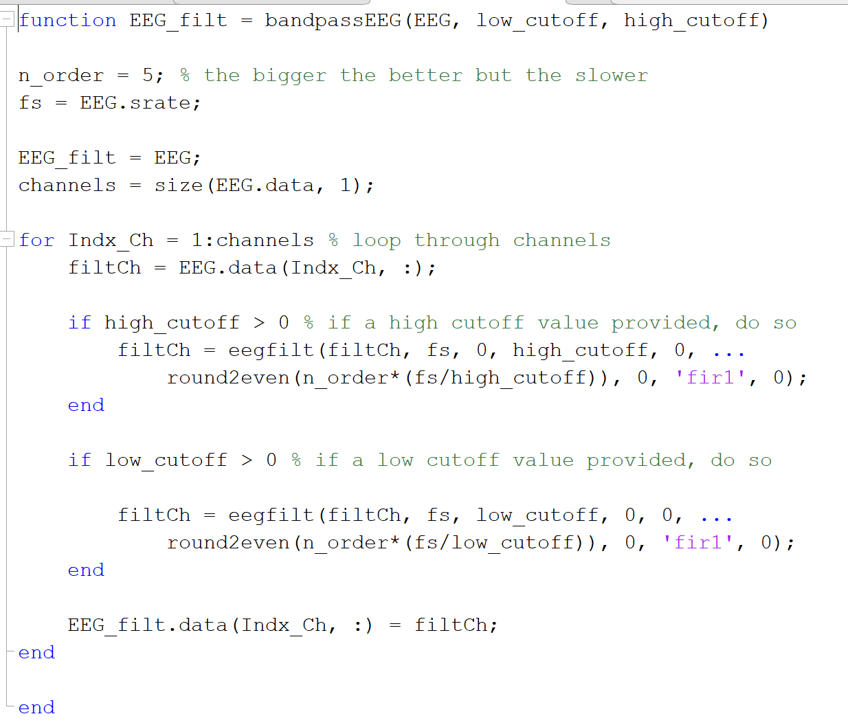
Highpass Filter, a.k.a. “Sven’s Filter”

Slide 15
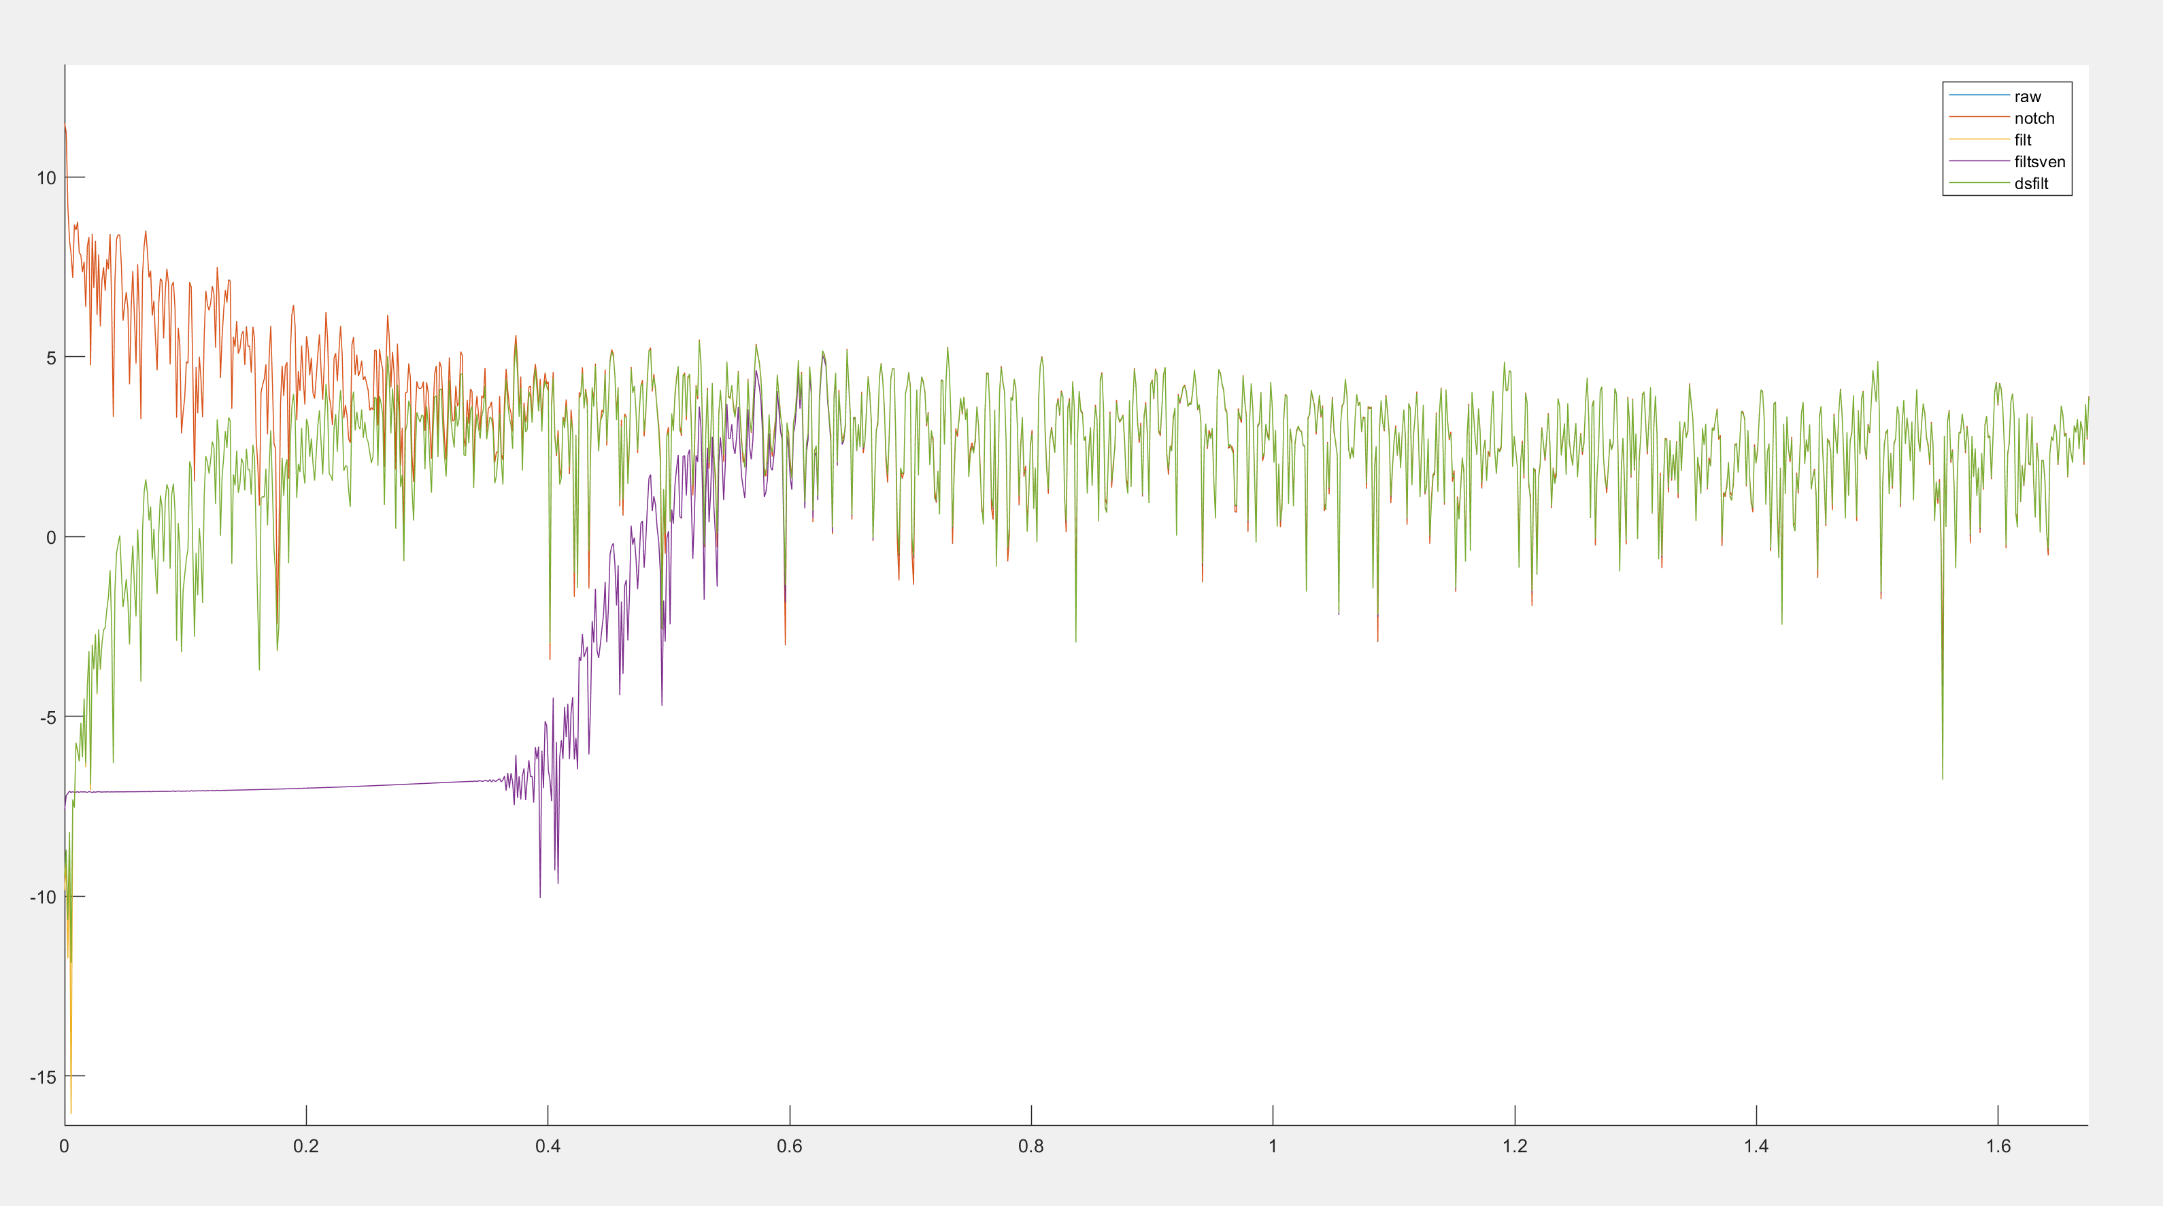
Note: Now, sven’s filter performs much better (purple), thus it is used for HP
EEGLAB
Sven
Raw/Notch
Notes:
But it does much better with the higher frequencies

Slide 16
C: Cut data (wake)
Manually select bad data

Slide 17
Start from Lightly Filtered data
Automatically identify highly noisy segments of data (could be better)
Visualize data and auto suggestions, and add or remove bad segments as needed
Identify whole channels that are bad
Drag over epochs where there was a major body movement or similar
Identify snippets of data in 1-2 channels where the signal went haywire but the rest of the eeg is ok
Saves a .mat file for each eeg file indicating the timepoints of these cuts. They will not be removed until the final steps though

Slide 18
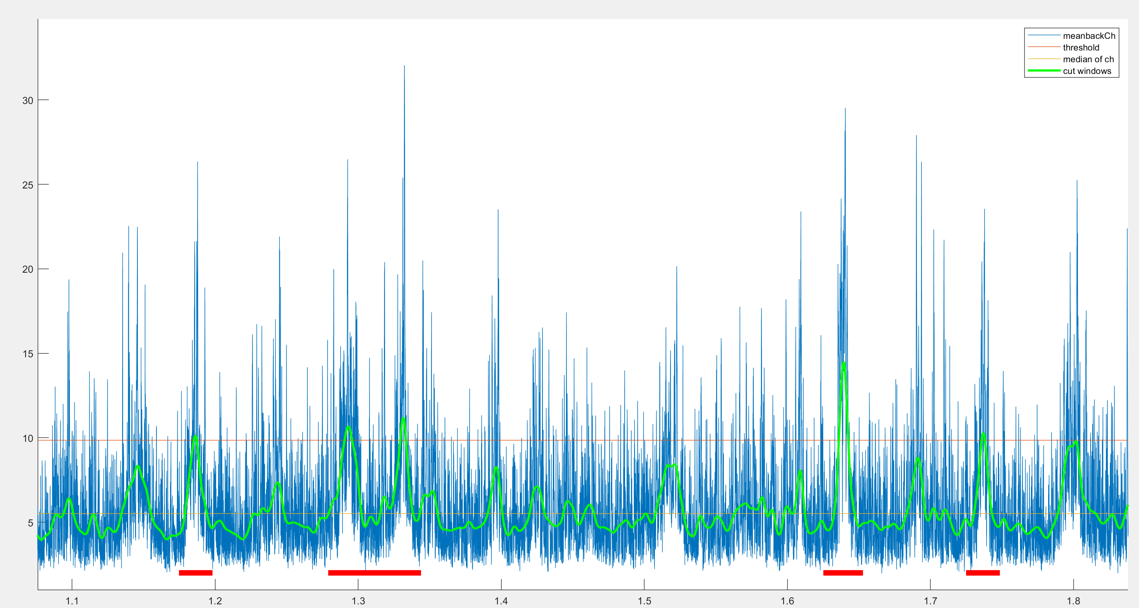
Automatic noise detection
Smoothed data (derived from the average across channels of the absolute voltage) above threshold marks timepoint as noise
Reaching median, then + 2 seconds indicates end of noise

Slide 19
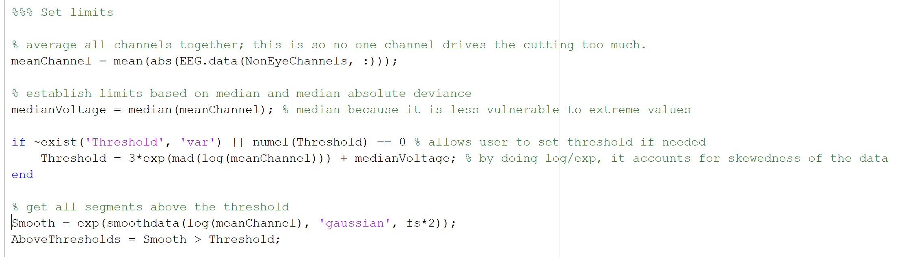
Automatic noise detection
Note: Only use channels > 30, because eye noise can be removed with ICA
Note: use median (and MAD) because the distribution is skewed
Note: the exp/smooth/log sequence was identified through trial and error, to obtain the green line on the next slide
Start and stop segments when crossing medianVoltage + 2 seconds
Merge segments that are <10s apart.
Note: also by trial and error, I noticed that returning to the median did not always indicate the end of the noise, thus the padding
Note: This is because noise that close together usually continued, but actually manually I ended up breaking up a lot of these segments to save data, so may not best idea

Slide 20
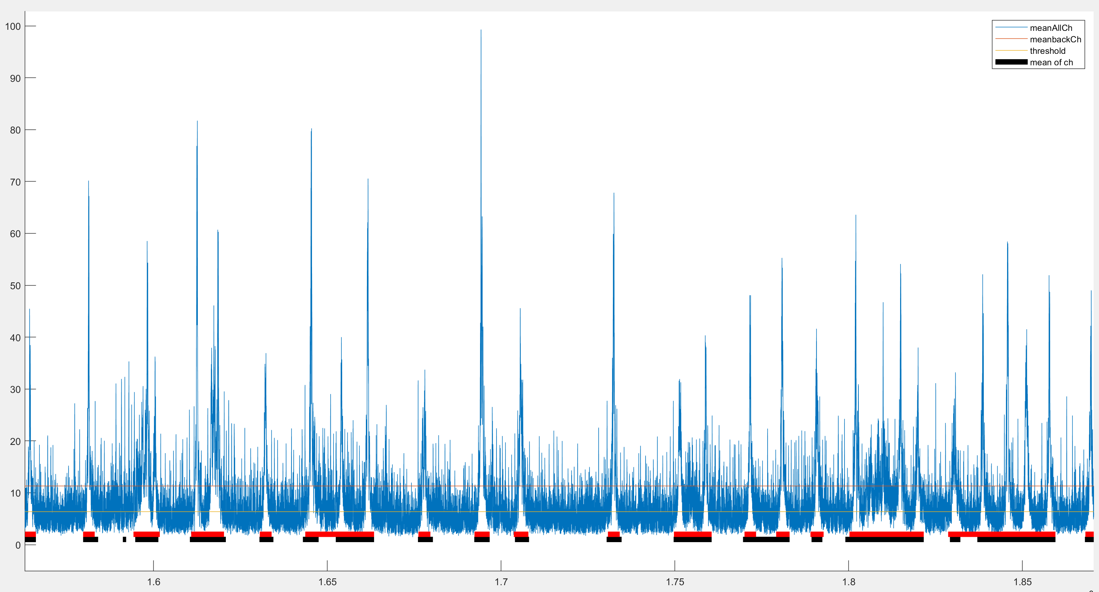
Manually removed: 65 min (tot 85 min)
Auto removed: 40 min
90% of auto removed was manually removed. (56% of manual was auto removed)
Does pretty ok

Slide 21
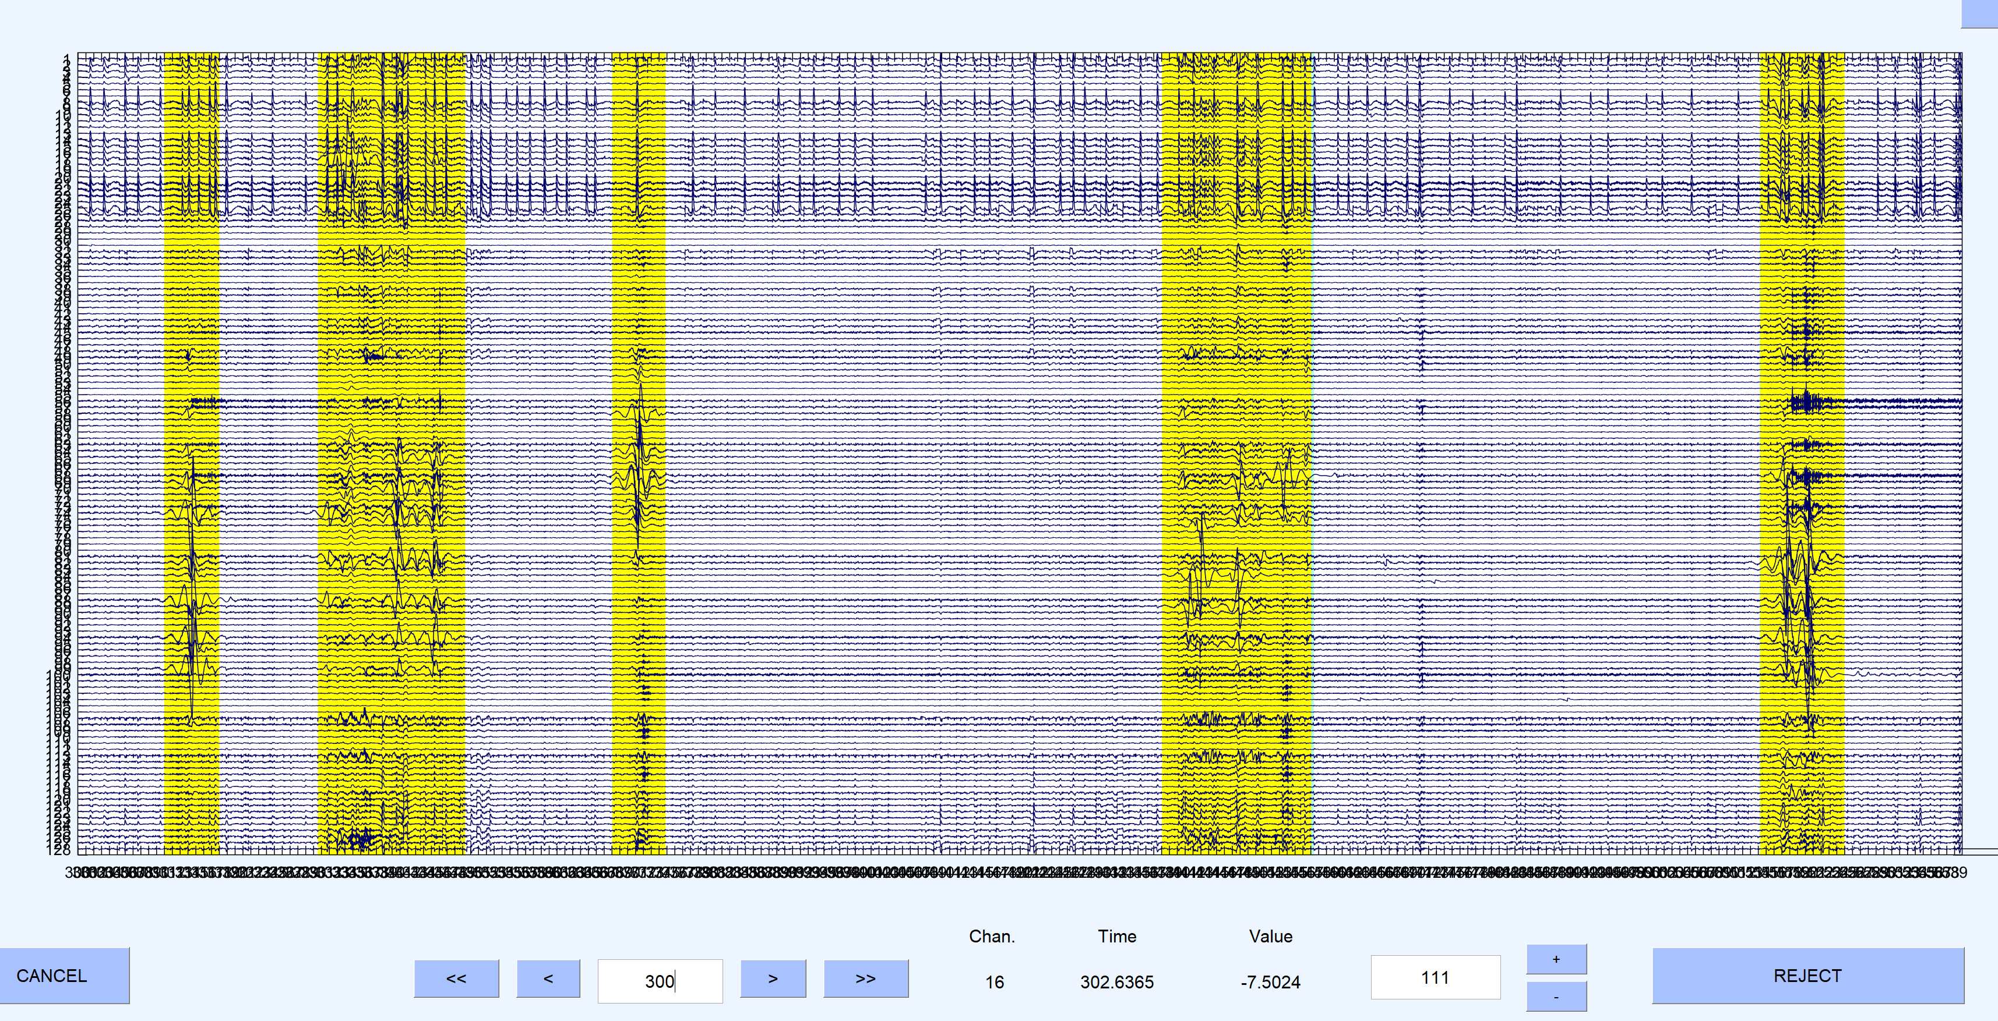
Does pretty ok

Slide 22
What gets cut (manually)
“Epochs”: several seconds of data where there is a major artefact affecting many channels
Borders are flexibly determined, unlike usual epoching which first establishes the epochs, then removes the ones with any noise
My way preserves more data, but the standard epoching method will have to be used when dealing with trial locked analyses
These will get cut out entirely, just before analyses are conducted
“Snippets”: several seconds of data in 1-2 channels that went crazy
These get interpolated in stage E from the surrounding EEG channels, thus reducing how much data needs to be removed
Channels: entire channels can get flagged as noisy
These are also then interpolated in stage E

Slide 23
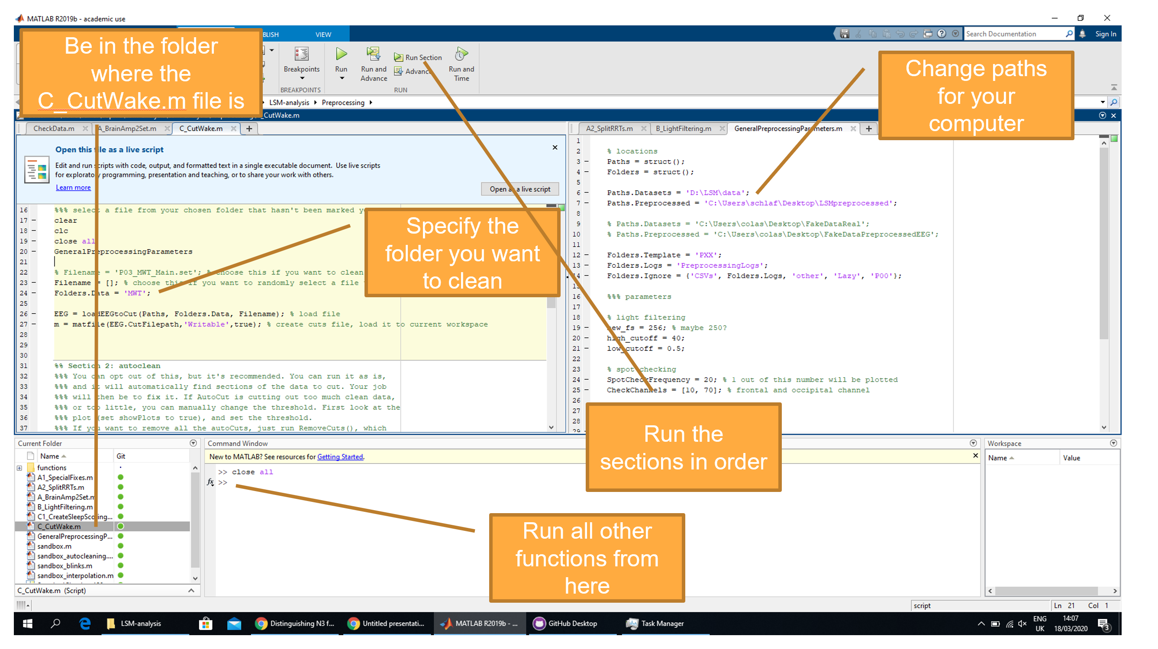
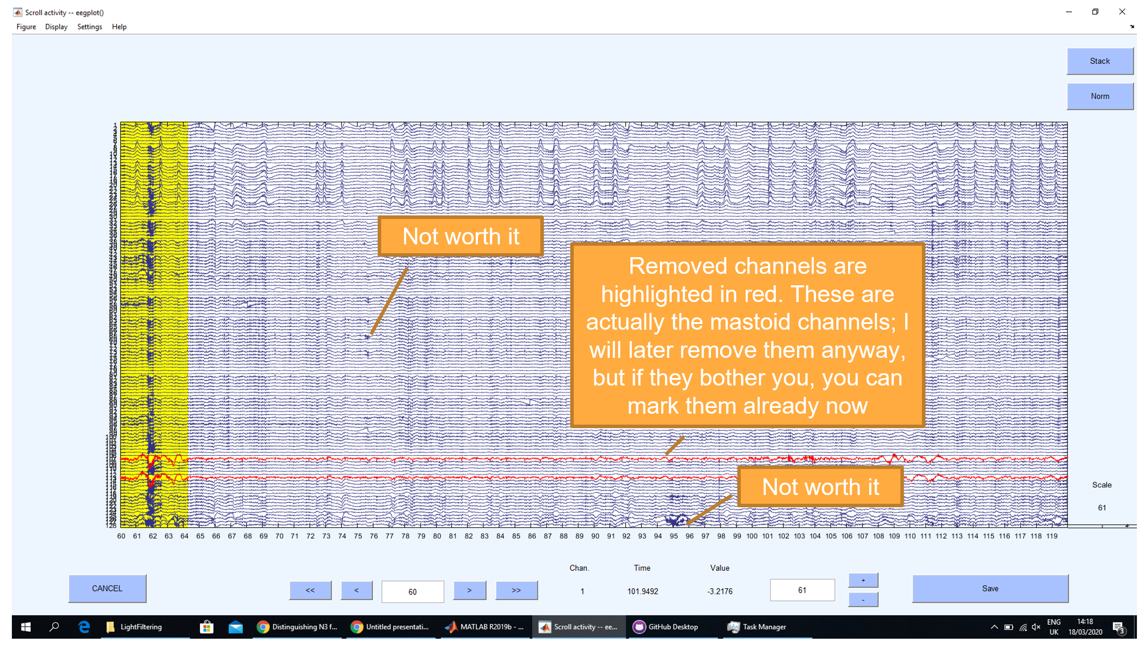
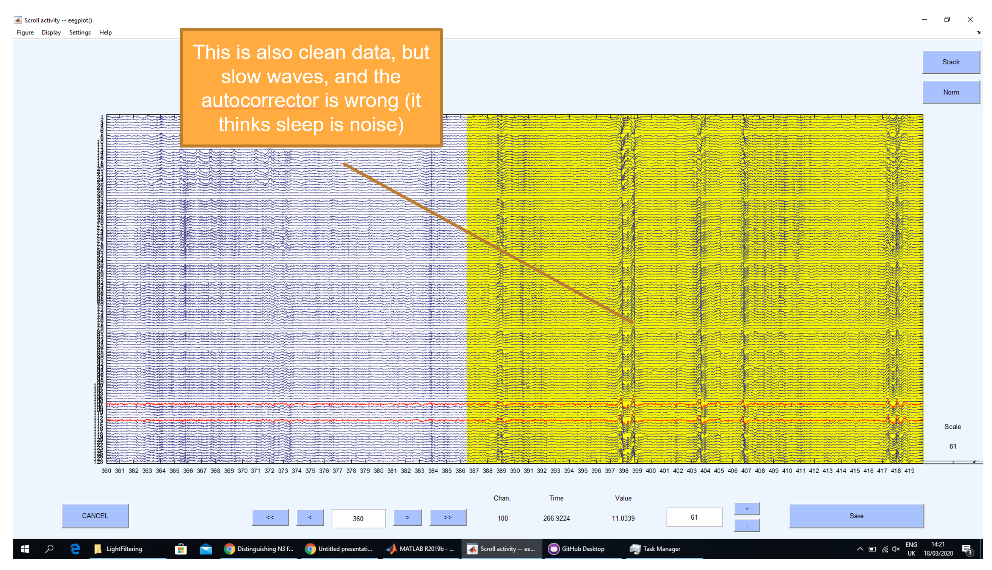
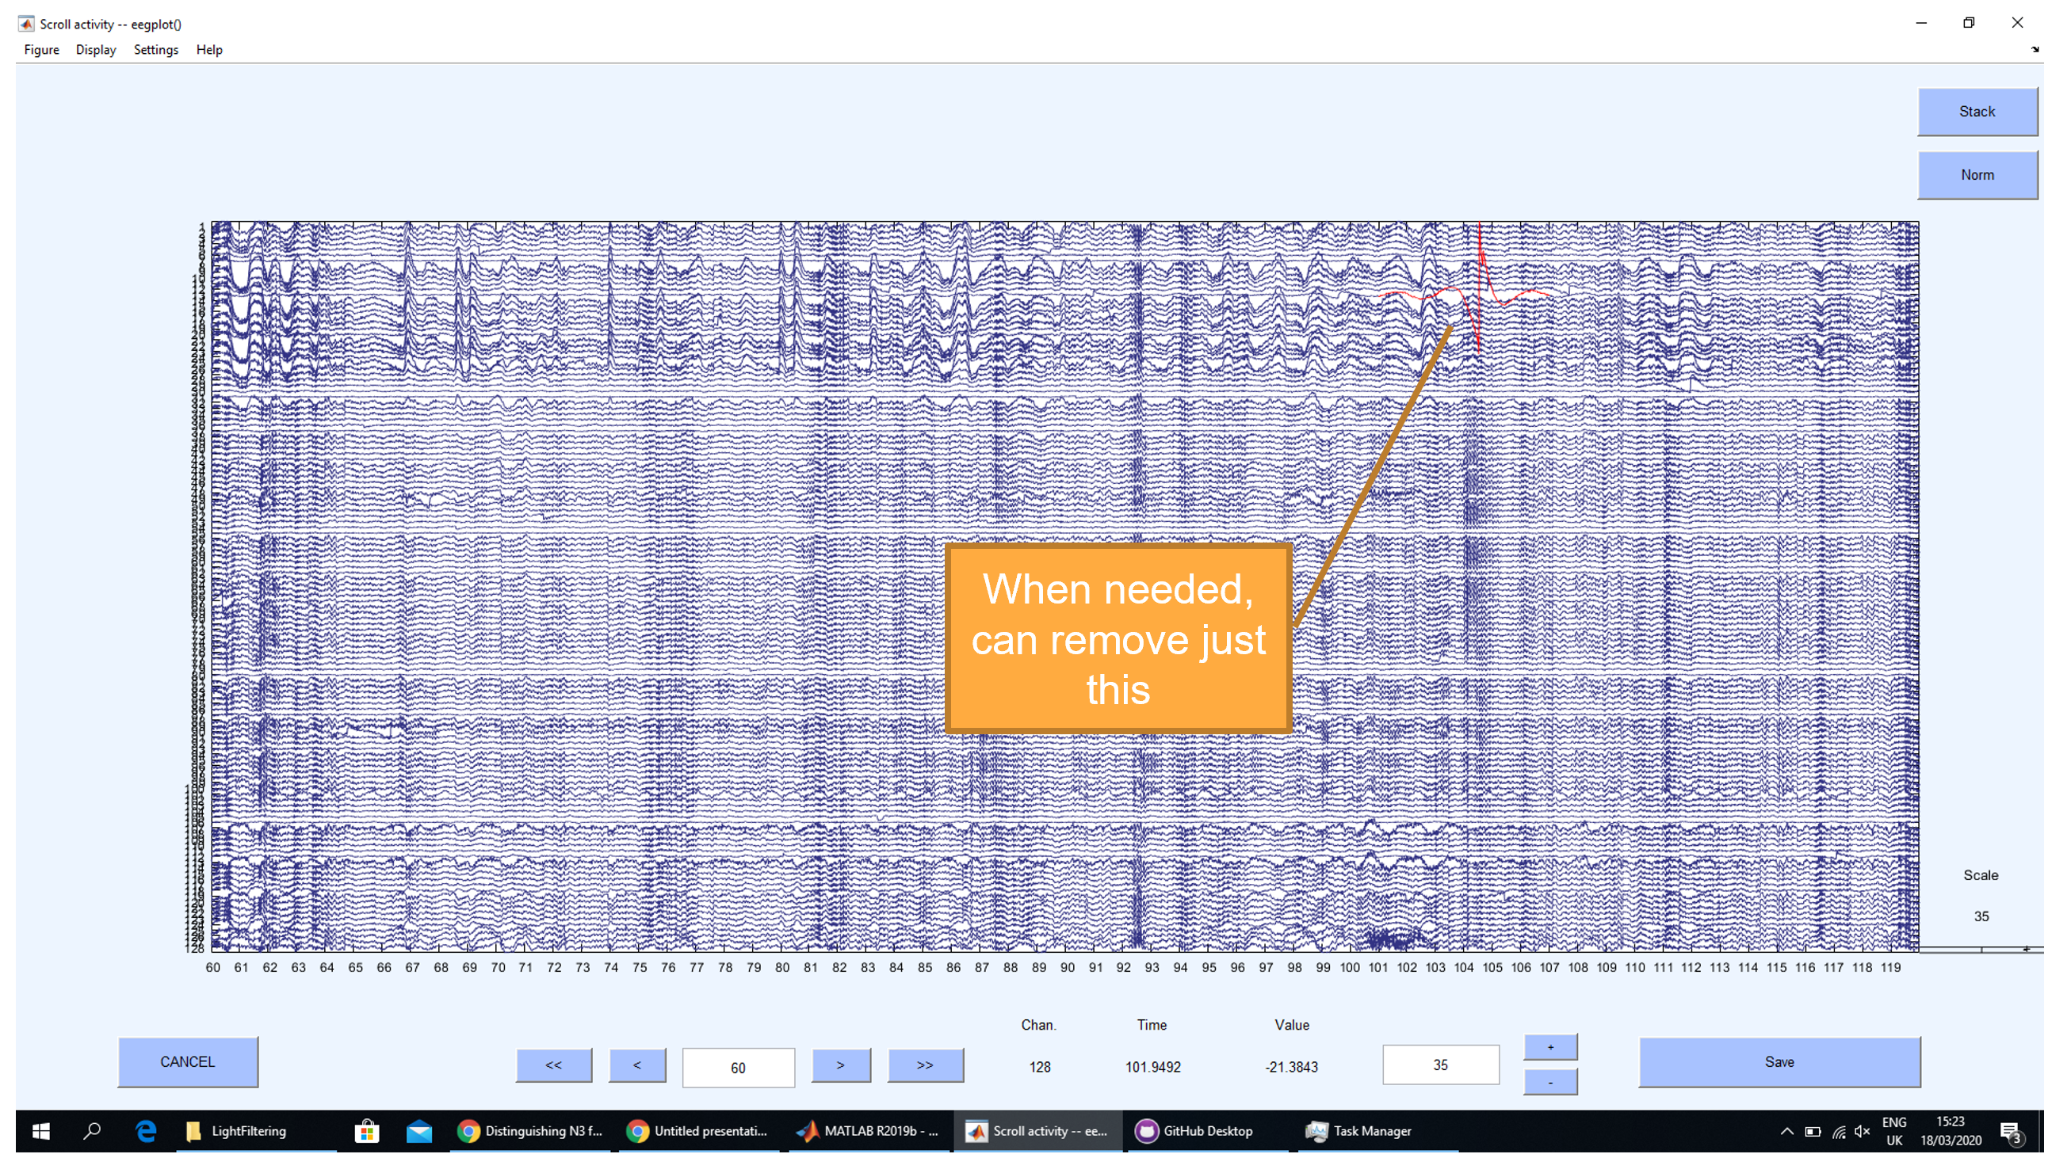
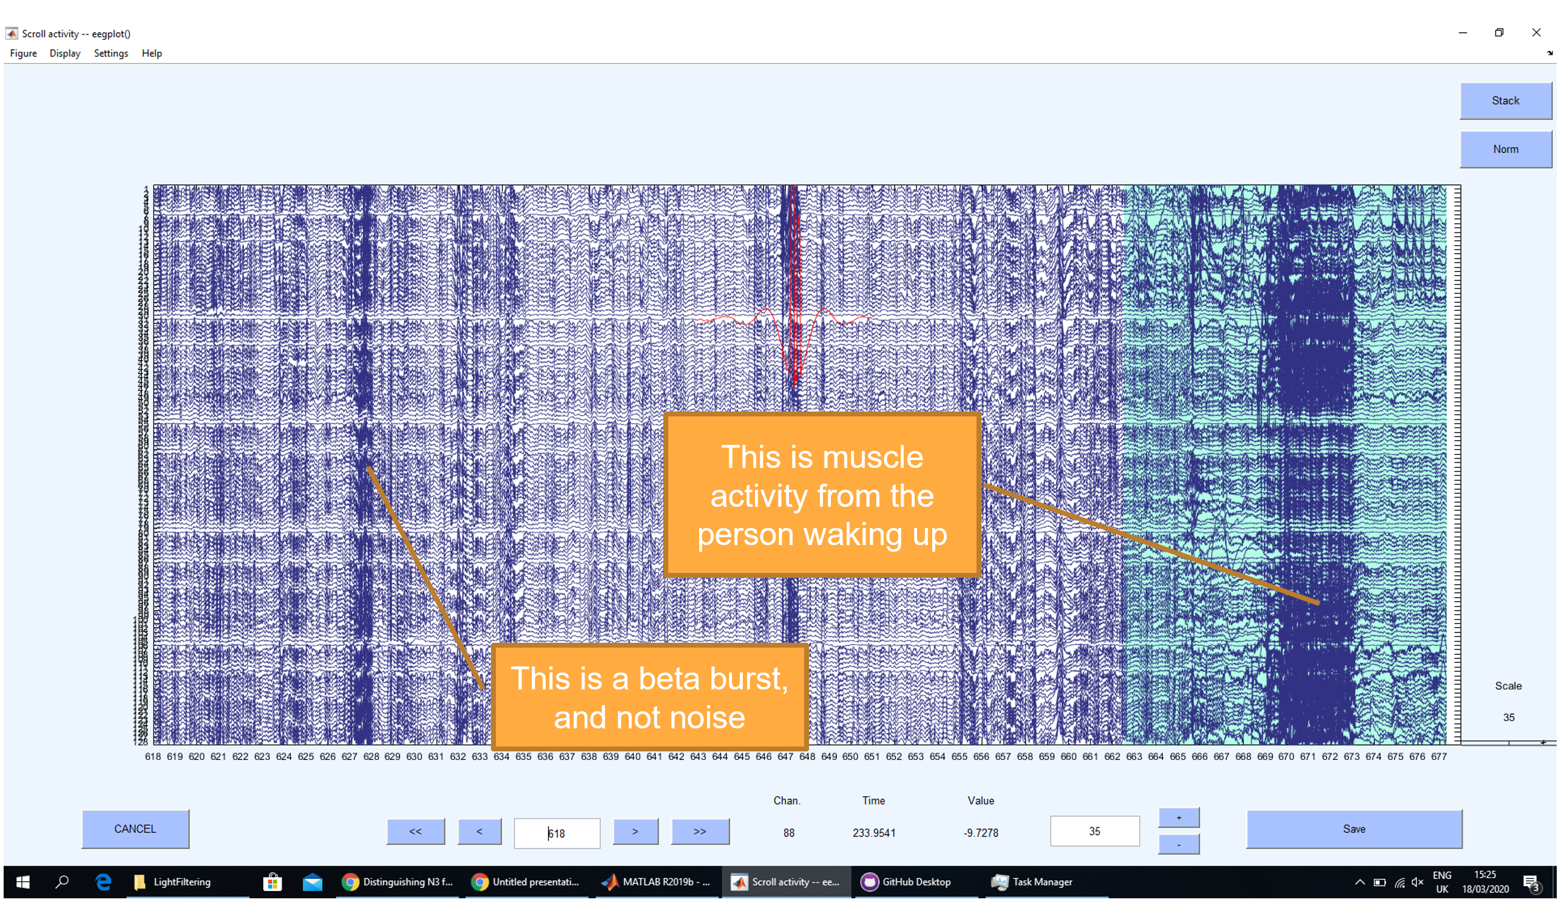
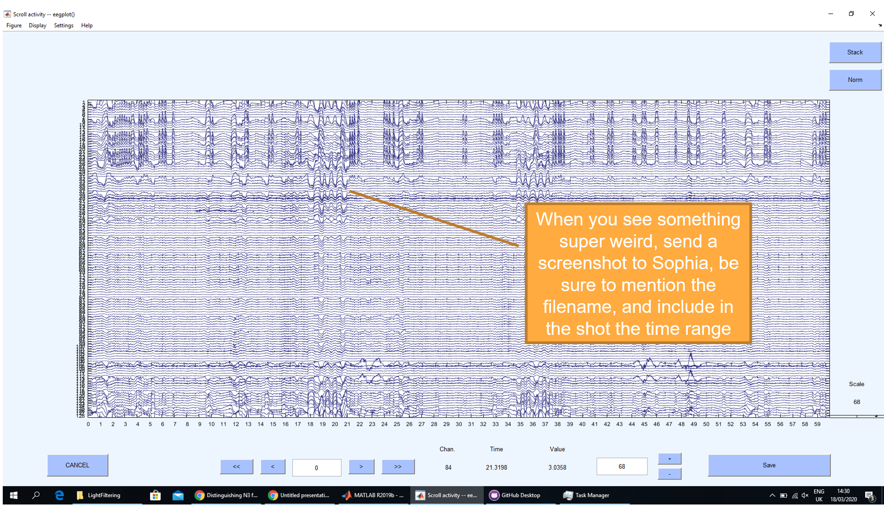
How to Cut Data
Separate series of slides indicating what to consider noise and how to use the scripts

Slide 24
D: ICA
Removing blinks and heartbeat

Slide 25
Start from Lightly Filtered data
Remove bad channels
Further filter the data from 1 to 30 Hz
Re-reference to average
Get ICA components with “runica”
Save data as “Heavy Filtered” data
Go through each file with EEGLAB’s GUI, plot the topoplots of the first 30 components, and select blinks and heartbeat
Save screenshot of chosen components, save to task slides
Remove components, save in folder “Deblinked” and check data to be sure everything is fine

Slide 26
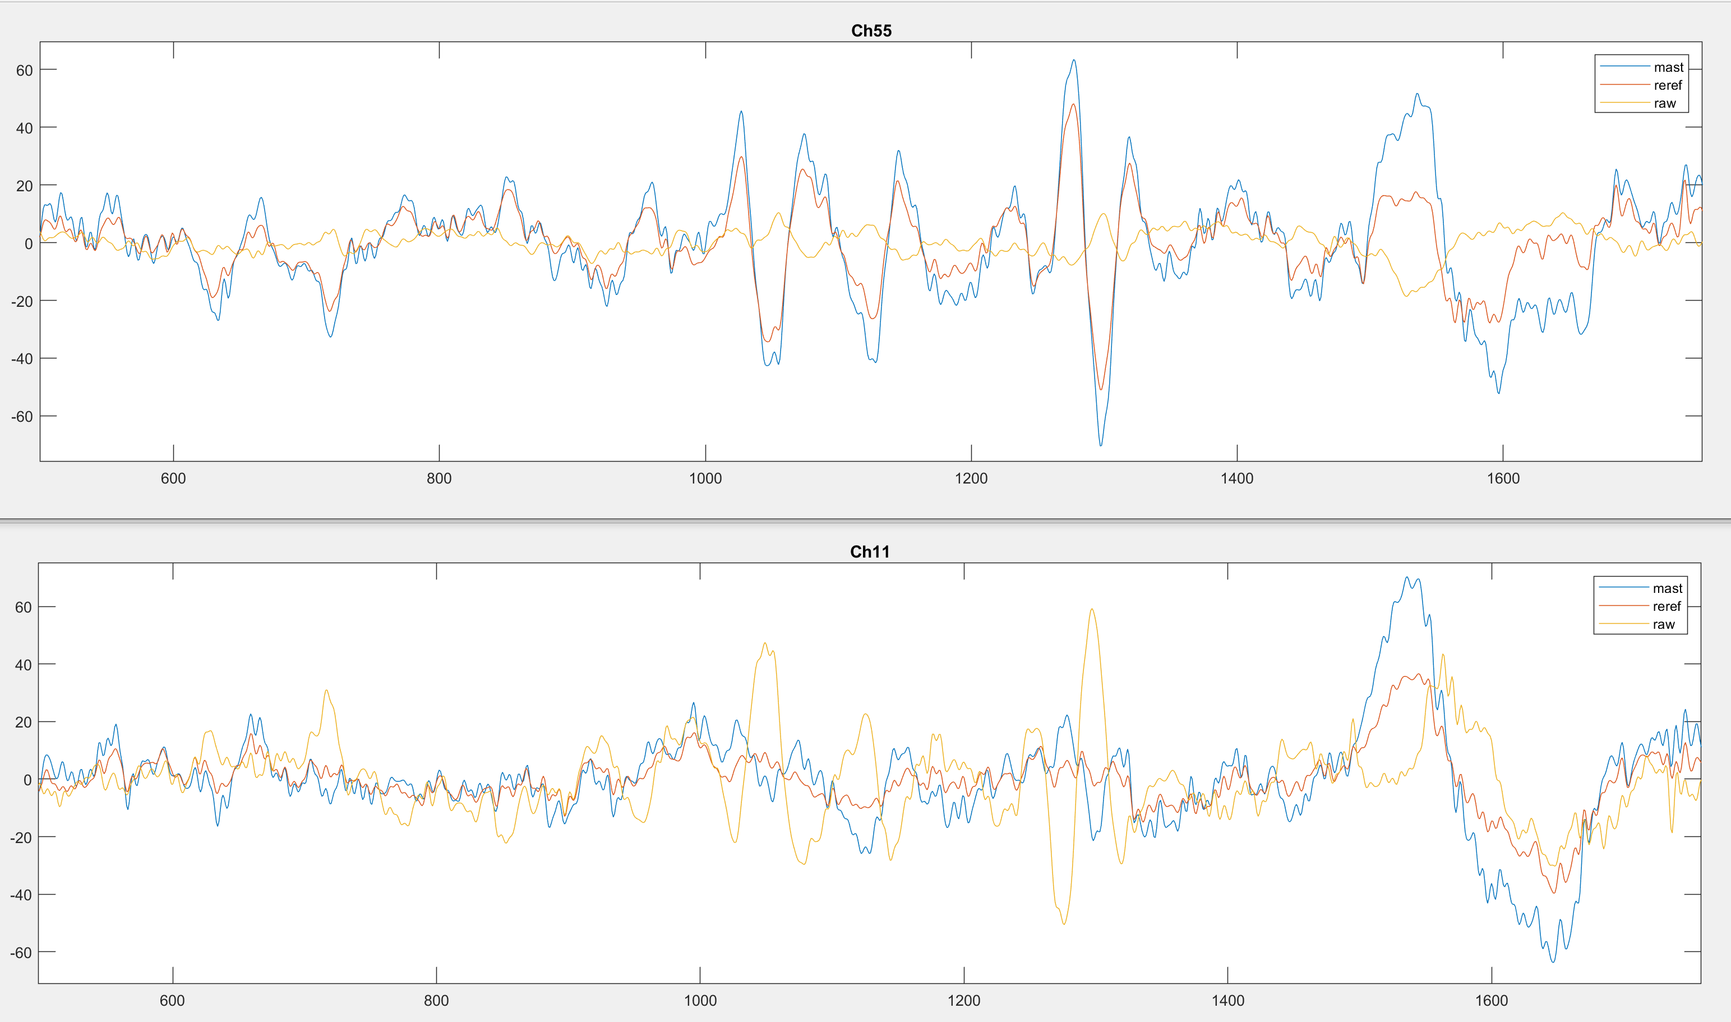
Rereferencing to Average
Cz reference smears its events to the rest of the data, making it seem like a bigger deal than it is

Slide 27
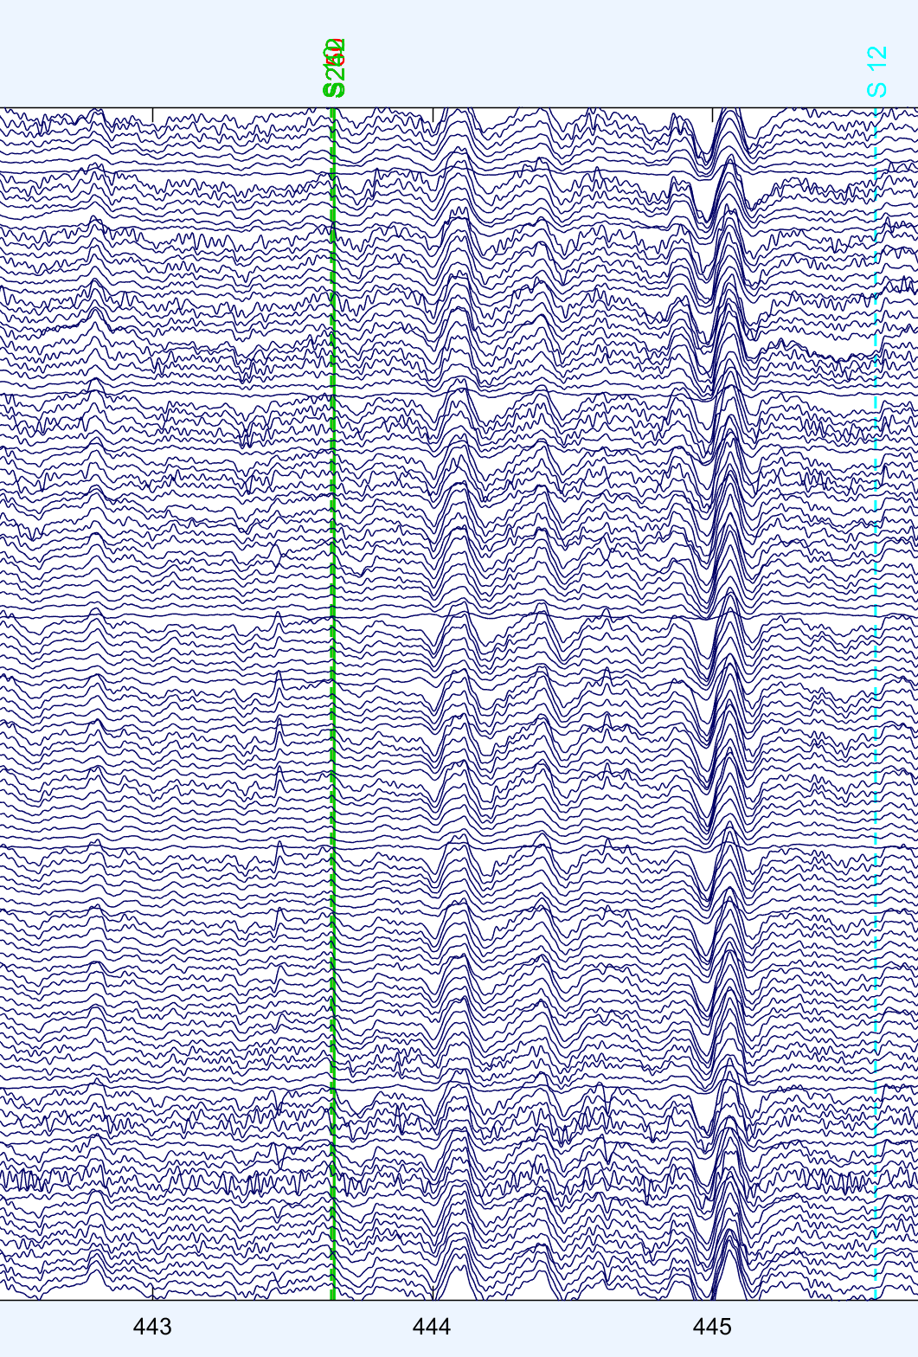
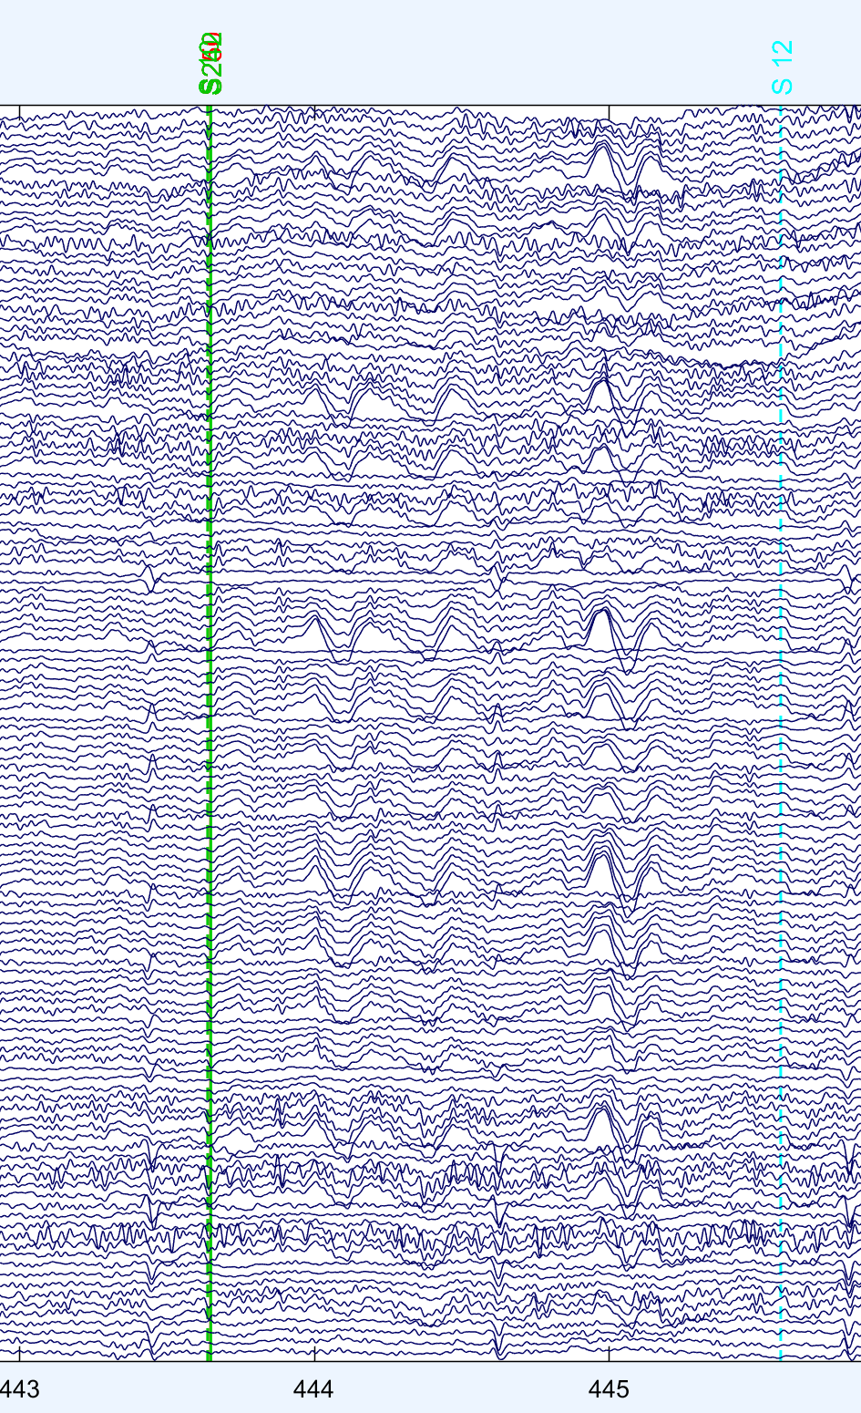
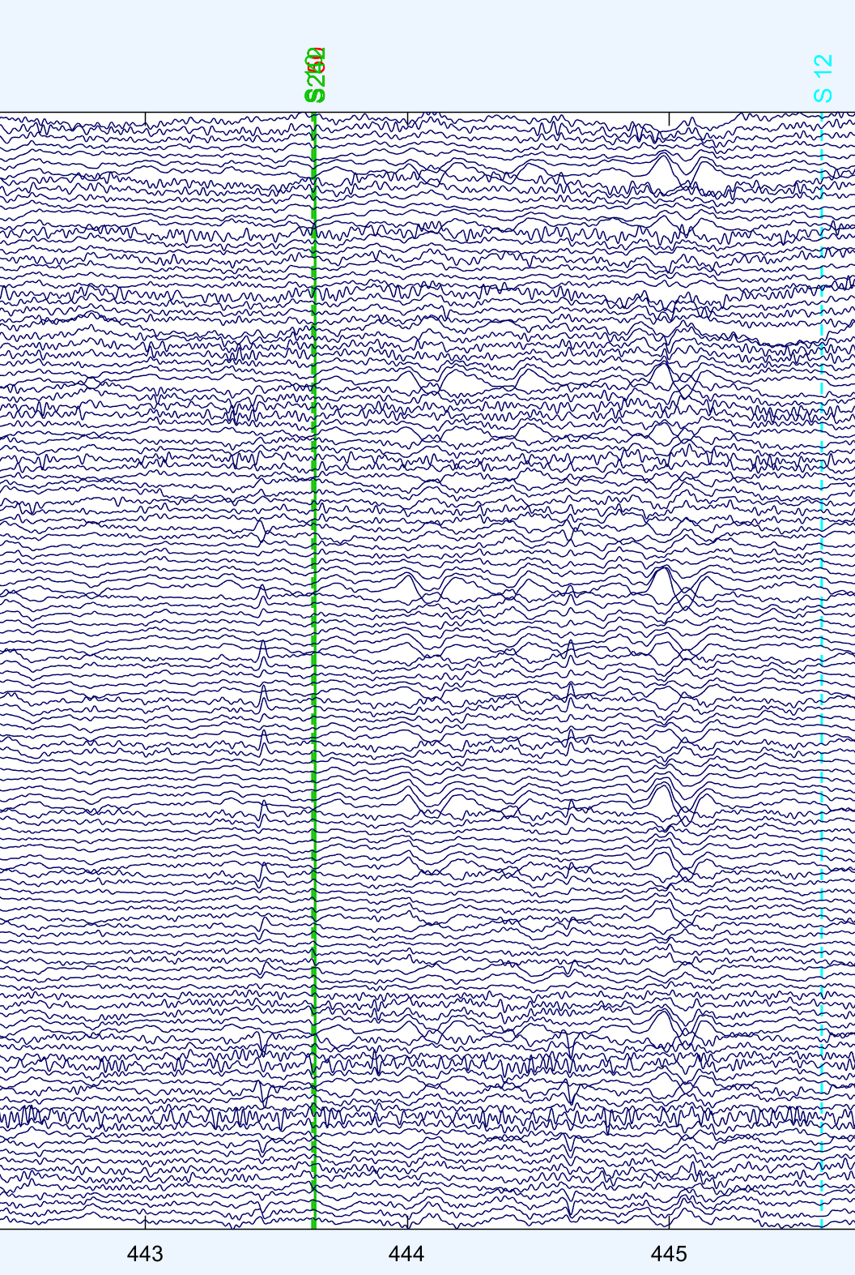
CZ Theta CZ ref
CZ Theta mastoid ref
CZ Theta Average ref

Slide 28
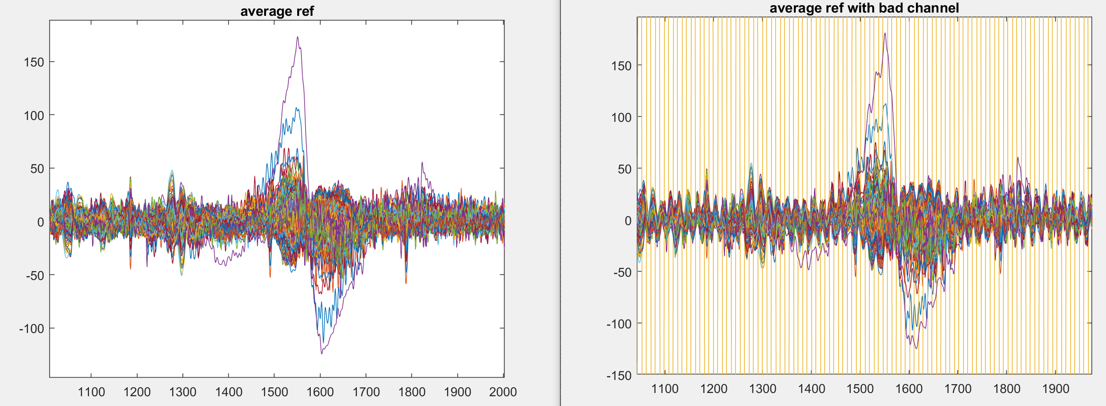
Need to remove bad channels before reref
When adding a fake bad channel, it smears its bad info to all the other channels; boooo

Slide 29
Removing bad ch and non eeg ch before hand

Slide 30
Criterion for ICA components to remove
Maximum top 5 eye components
Identified as blobs in the eye region, and nothing elsewhere in the topoplot
Needs to be spread out in time (as shown in “trials” plot); single event components are ignored (because cut out later)
Power spectrum needs to look very non-brainlike
Maximum top 2 heartbeat components
Identified by lopsided halo look, and regular dots in trials plot
There’s a separate set of slides with instructions explaining all the types of components

Slide 31
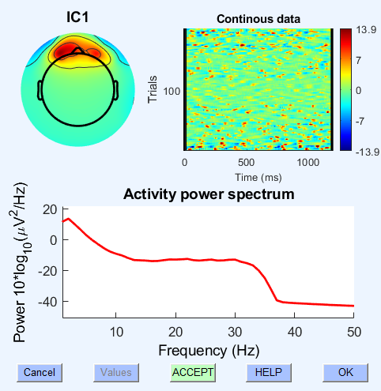
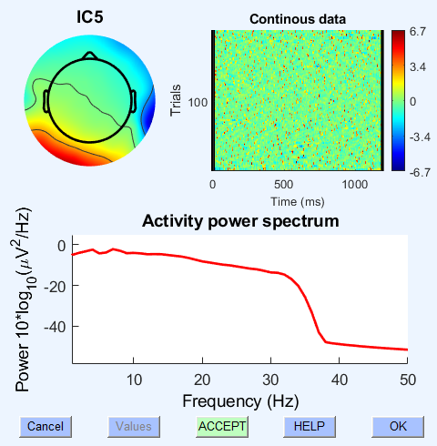
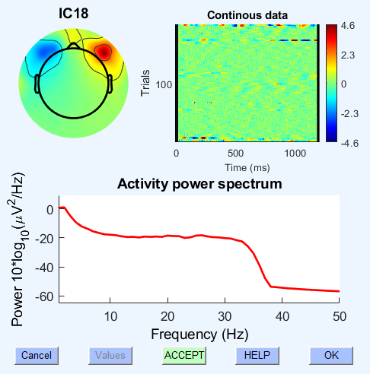
Components to Remove
Reject component
blink artefact
Reject component
Heartbeat
Reject component
Lateral eye movements

Slide 32
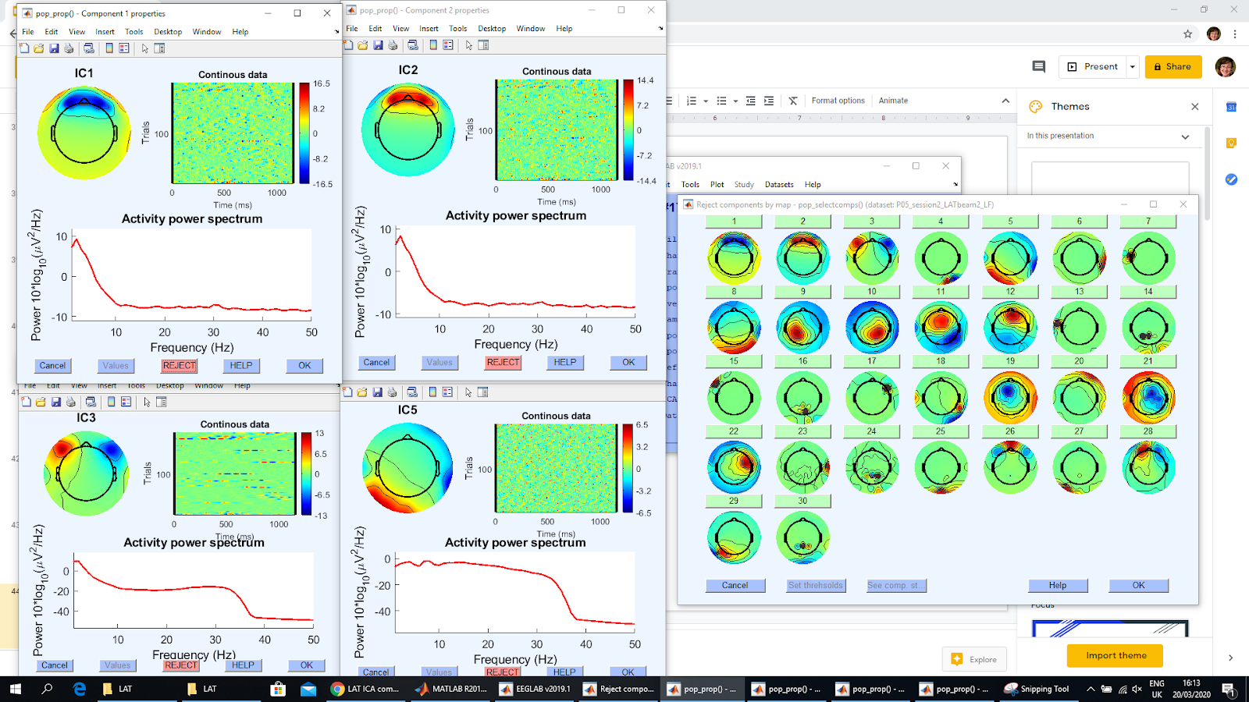
Example screenshot for keeping track of components removed

Slide 33
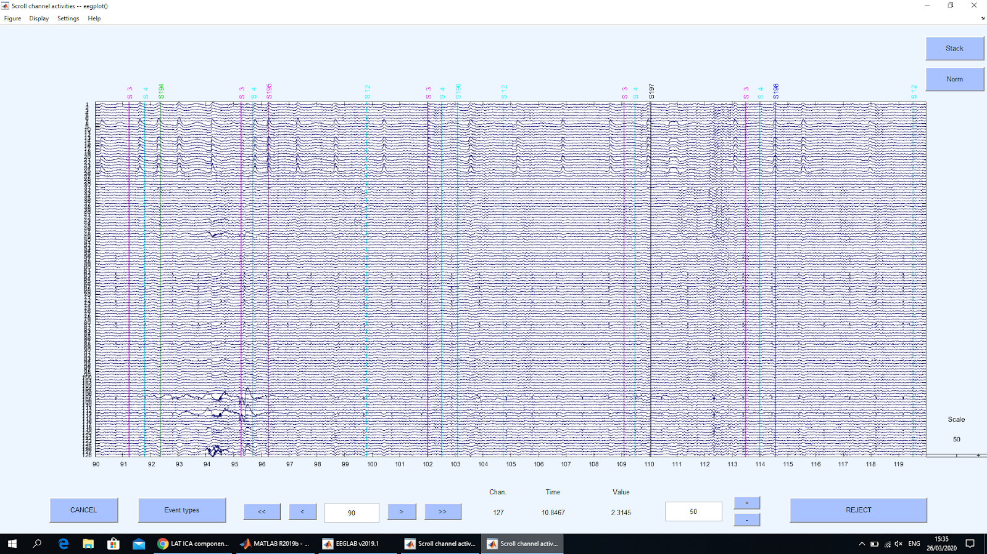
Before

Slide 34
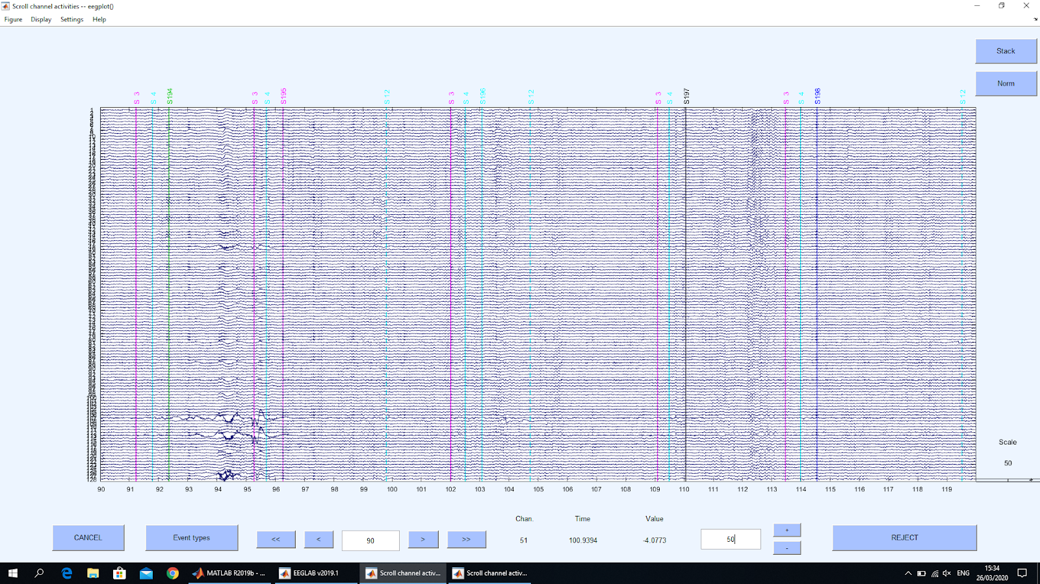
Note: it’s almost perfect, but there’s sometimes little ghosts around points where blinks used to be; given the relative effect sizes though, I prefer to keep these ghost blinks than the real ones; but it’s something to keep in mind
After

Slide 35
Note
ICA is done before interpolating or removing bad epochs because anything you do to sections of the data end up reflected in different ICA components (discovered through trial and error)

Slide 36
E: Interpolate bad data
So as to allow nice looking topoplots and not have to cut too much data

Slide 37
Start from “deblinked” data
Script interpolates snippets of data identified in C
Identifies “clusters” to remove; basically merges overlapping segments of data in different channels to cut so they have the same start and end
For each cluster, cuts out a column of the EEG data for that cluster
Removes channels involved in the cluster, non EEG channels (face, EMG, mastoids), and “bad channels” (noisy channels identified manually in C)
Interpolates the removed channels using EEGLAB’s functions
Replaces the segments from the cluster (and not all the other removed channels) in a copy of the original EEG data
Removes bad channels from the cleaned EEG, interpolates them (again without using non EEG channels)
Saves as “Interpolated”; used for all other analyses

Slide 38
Ignoring cut data
This is conducted by the scripts that determine power and such

Slide 39
Start from Interpolated data
Remove non-EEG channels (face, neck, EMG, mastoids)
Set as “nan” (Not A Number) all EEG data points that are:
Outside of the start and stop triggers
Within epochs selected during C as noise (across all channels)
Run analyses, ignoring nans
Note: like this, noise doesn’t leak into power spectrums of bordering data, but also keeps data spaced at the original distance, so if I ever do a “first 5 min vs last 5 min” comparison, I can genuinely select the right timepoints. This would be a headache if I were to compress the data around the places I cut out.

Slide 40
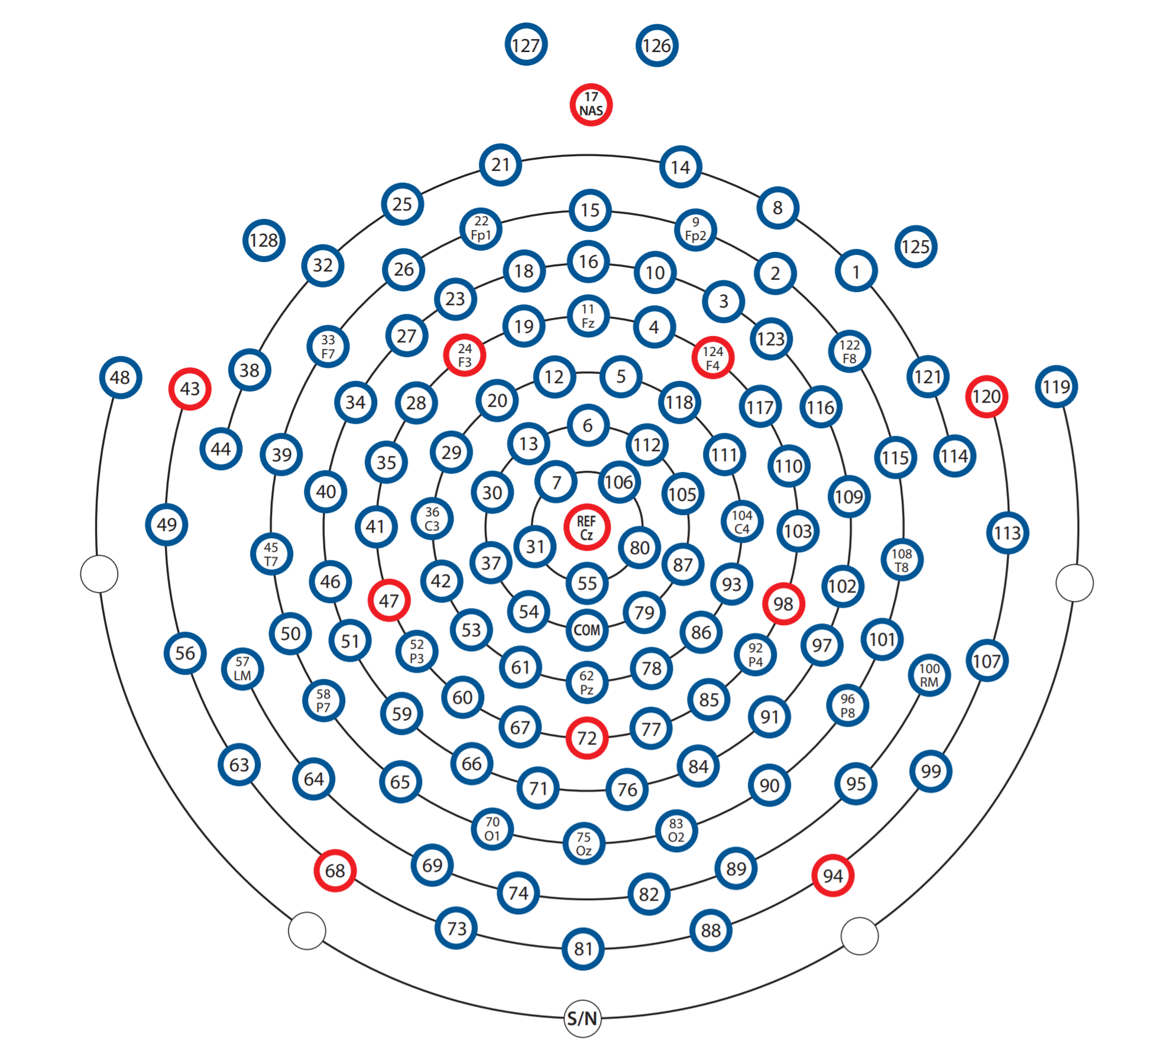
Bad Channels
Face
Neck
EMG
Mastoids

Slide 41
Front hotspot
back hotspot

Slide 42
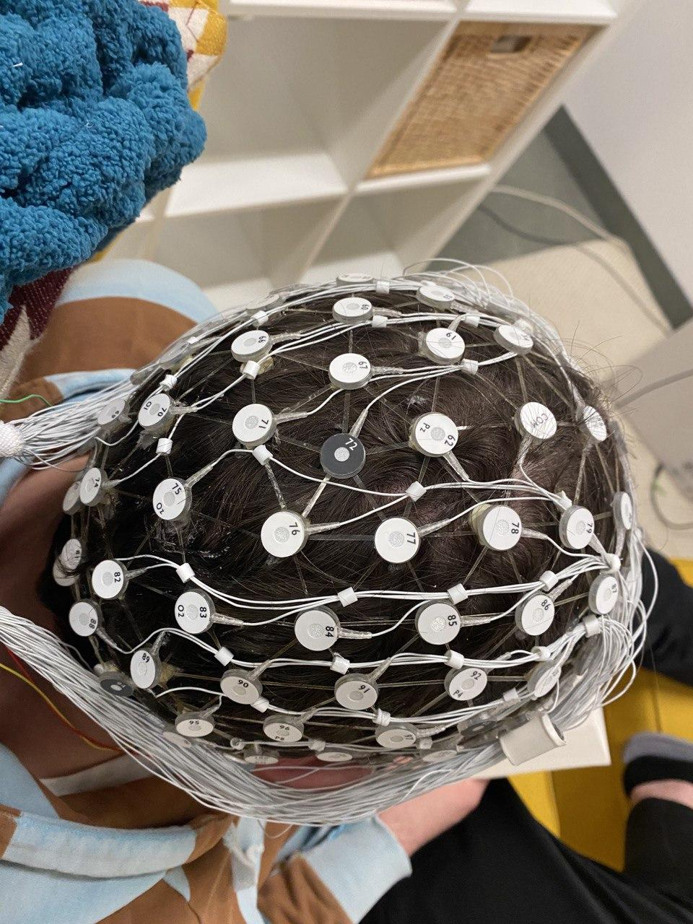
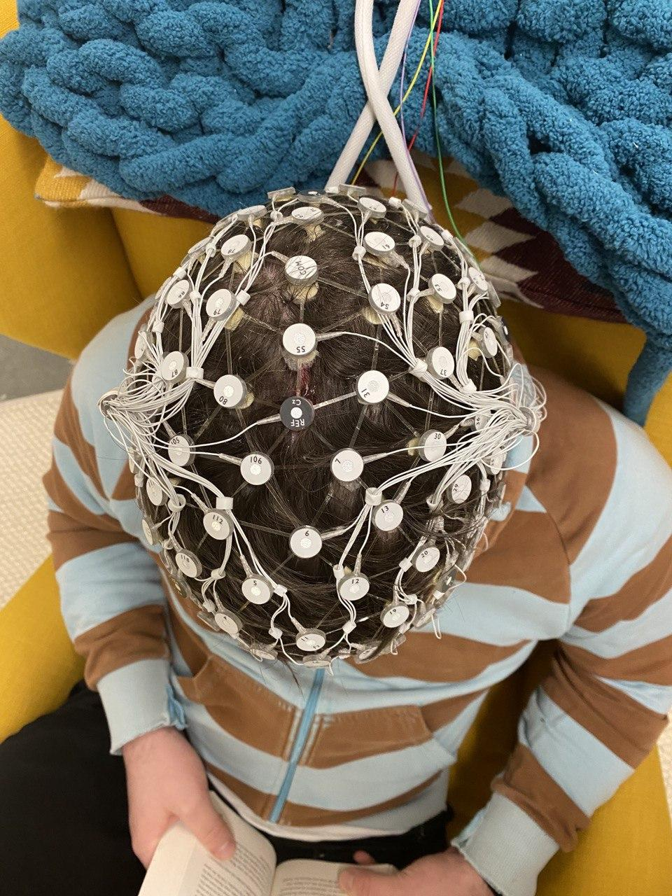
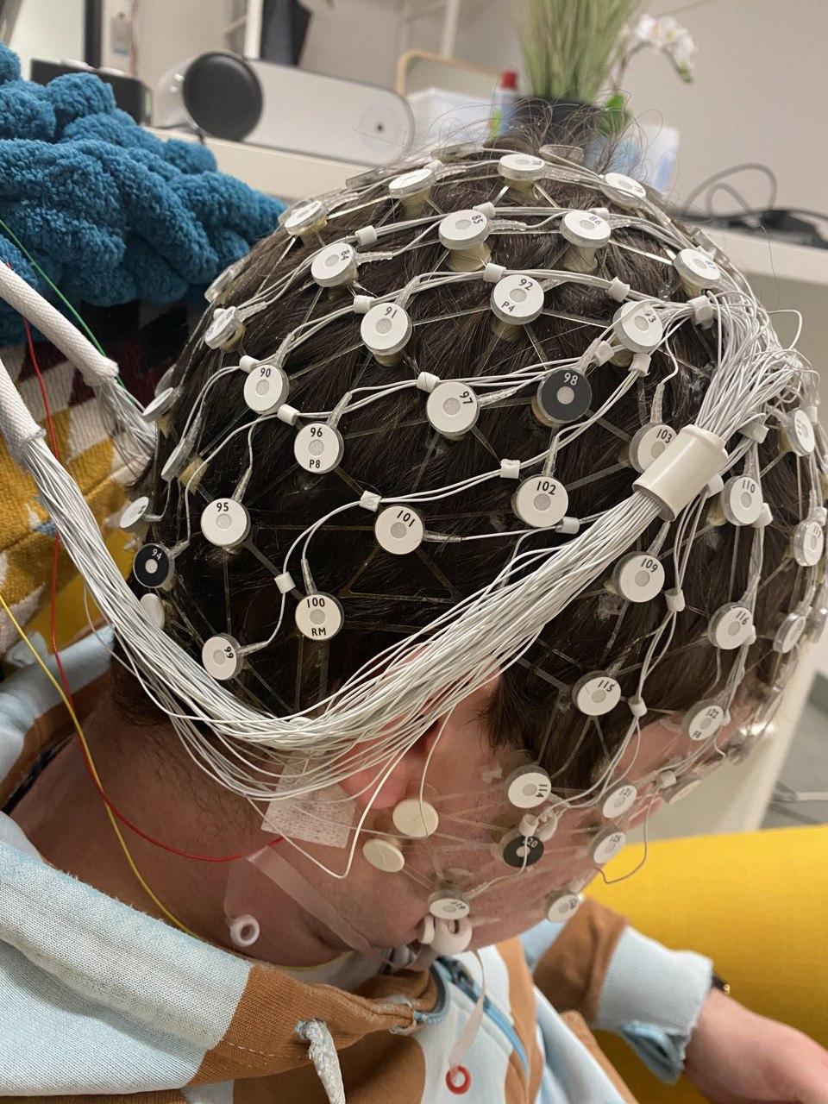
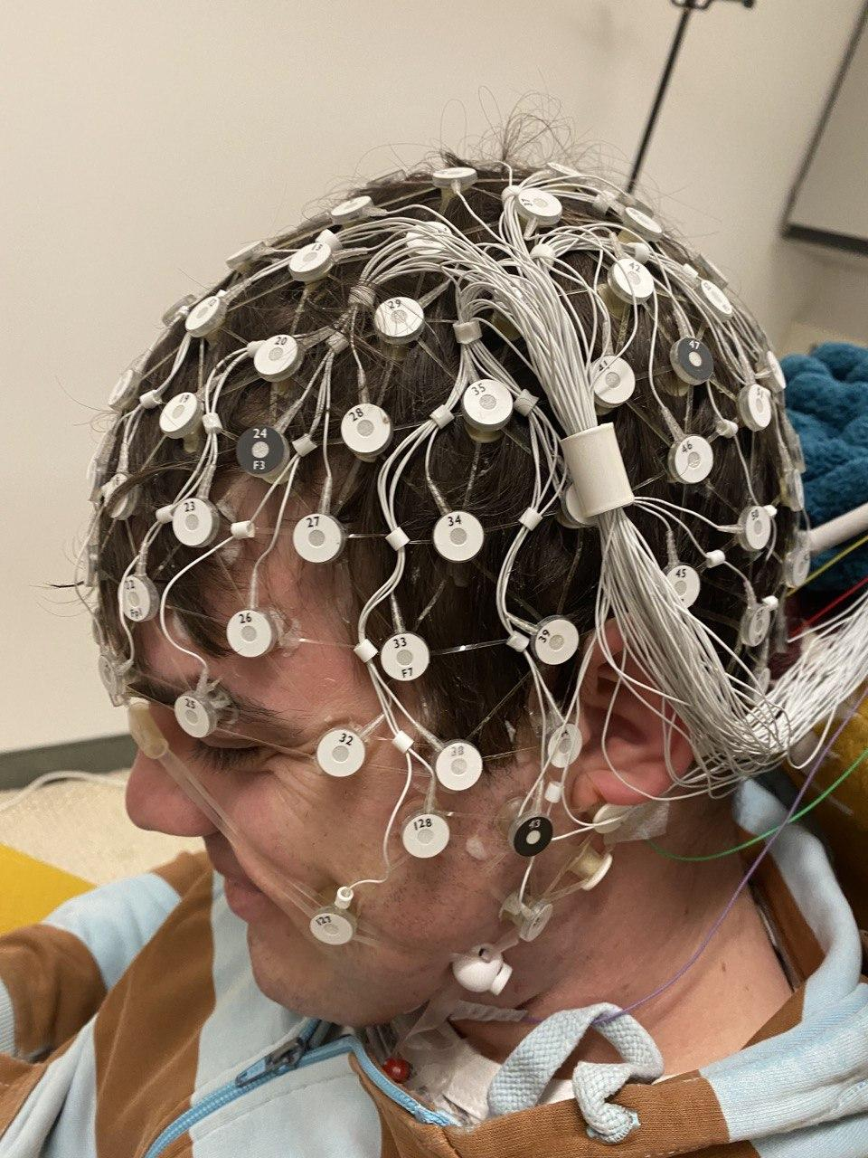
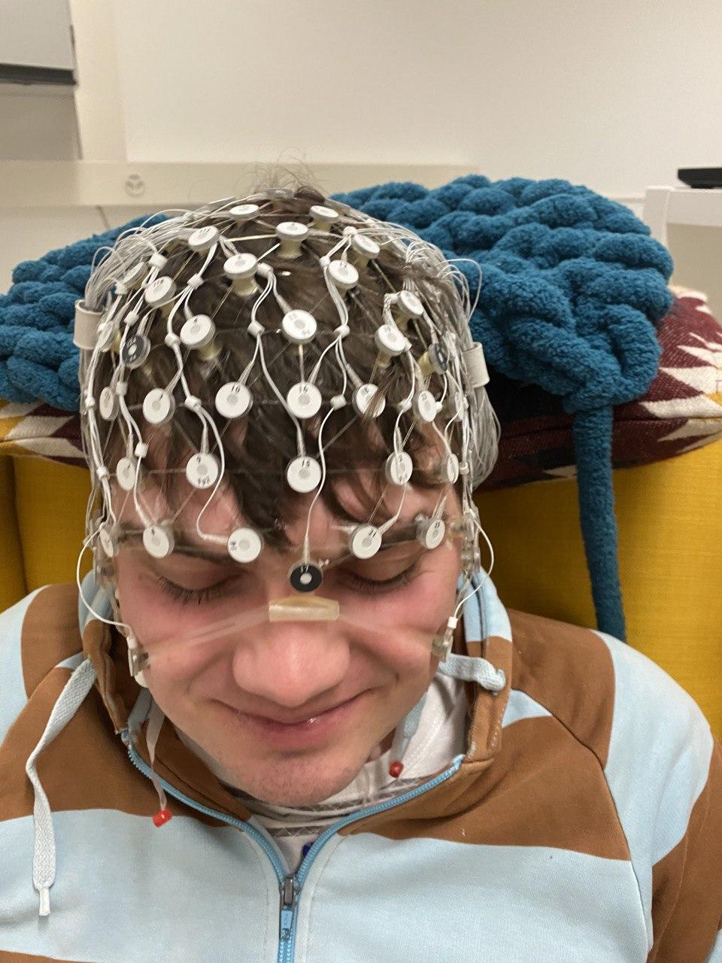

Slide 43
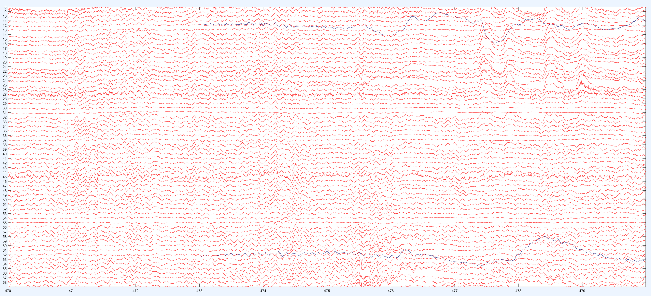
Interpolation

Slide 44
Final Outcome
Proof that everything works

Slide 45
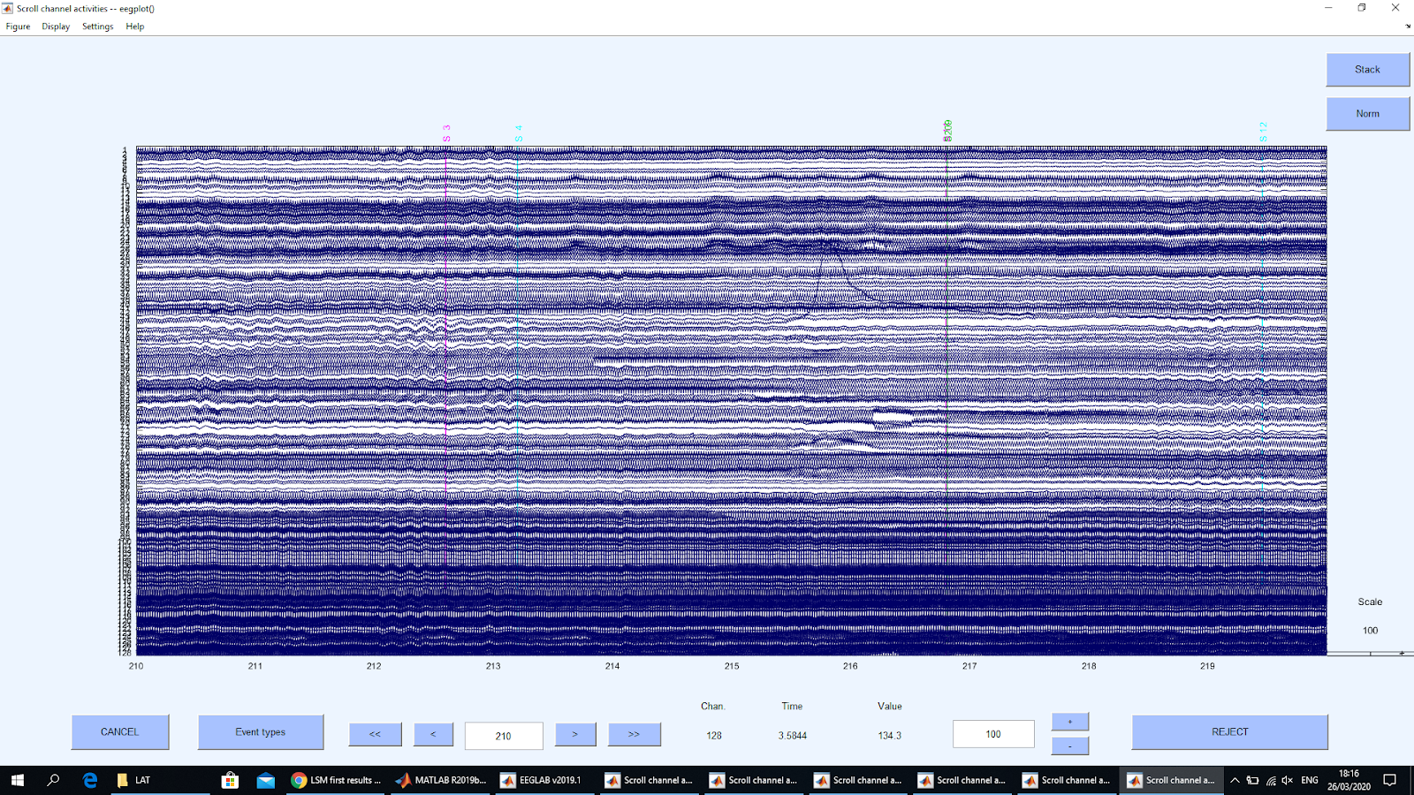
Raw (different scale from rest of plots)

Slide 46
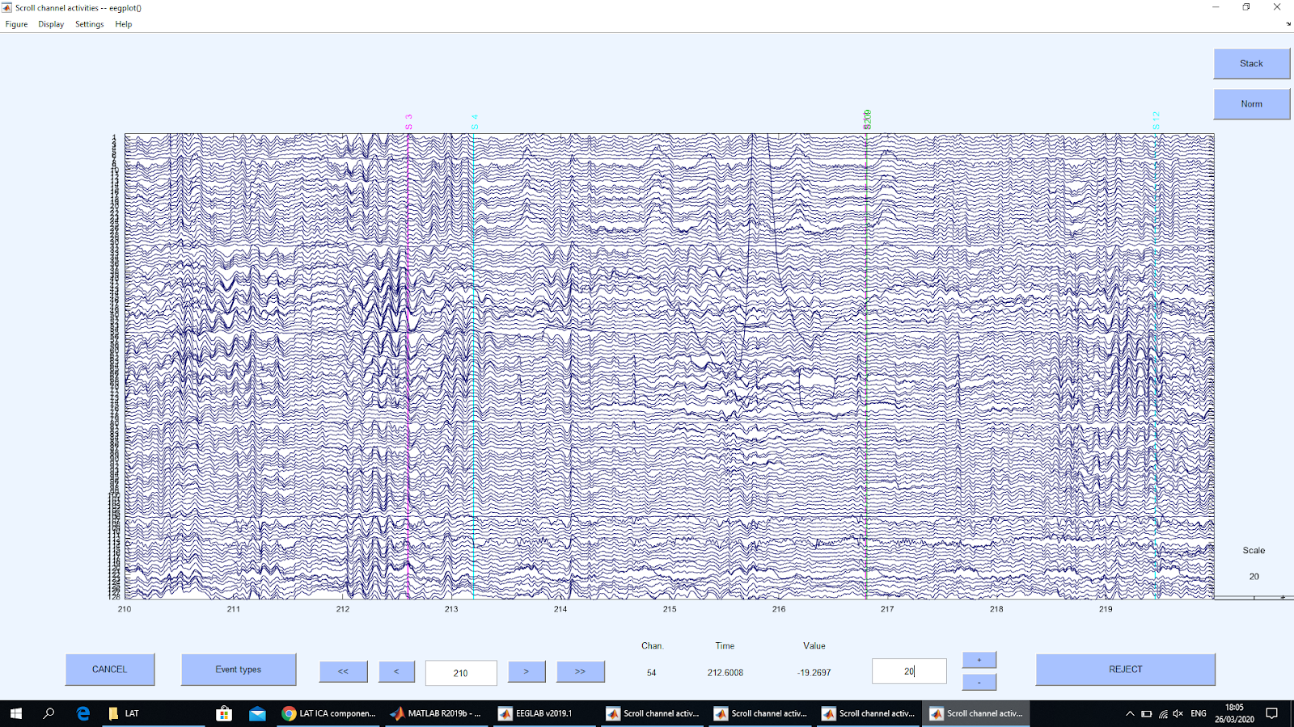
Light Filtering

Slide 47
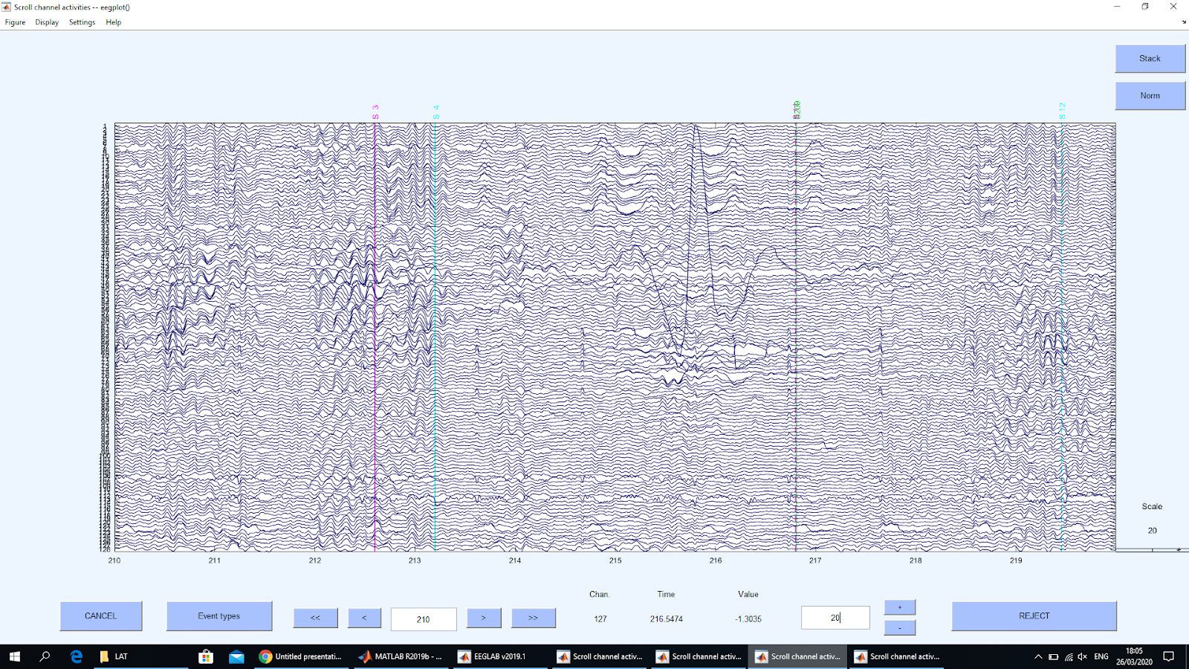
Heavy Filtered (+ rereferenced)

Slide 48
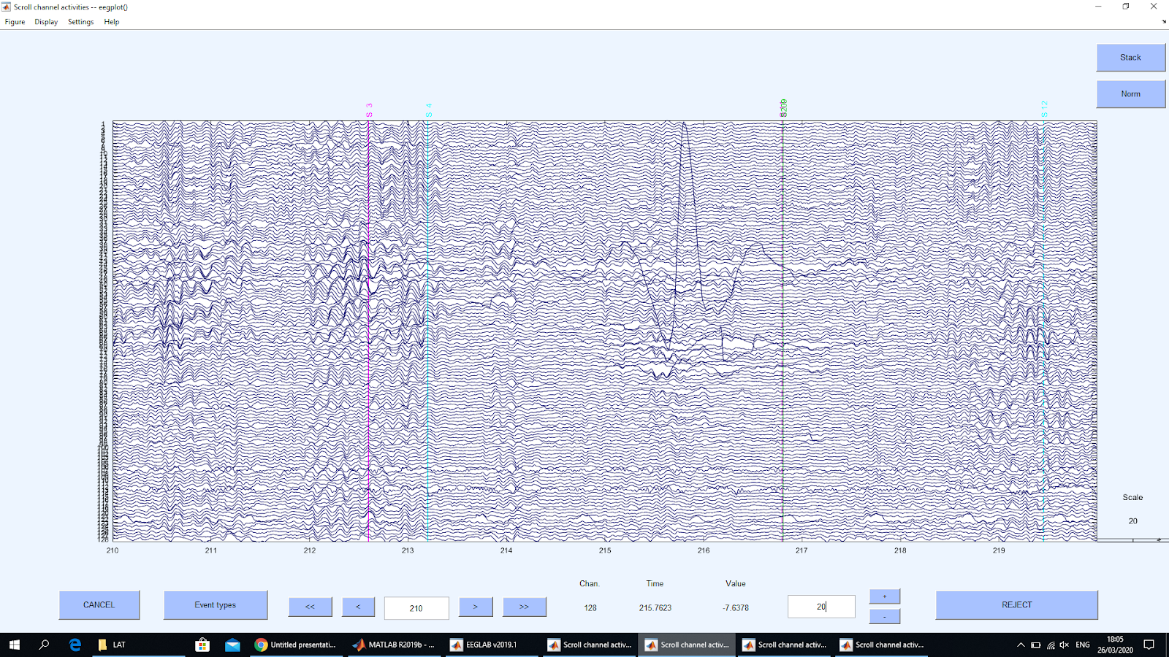
Deblinked

Slide 49
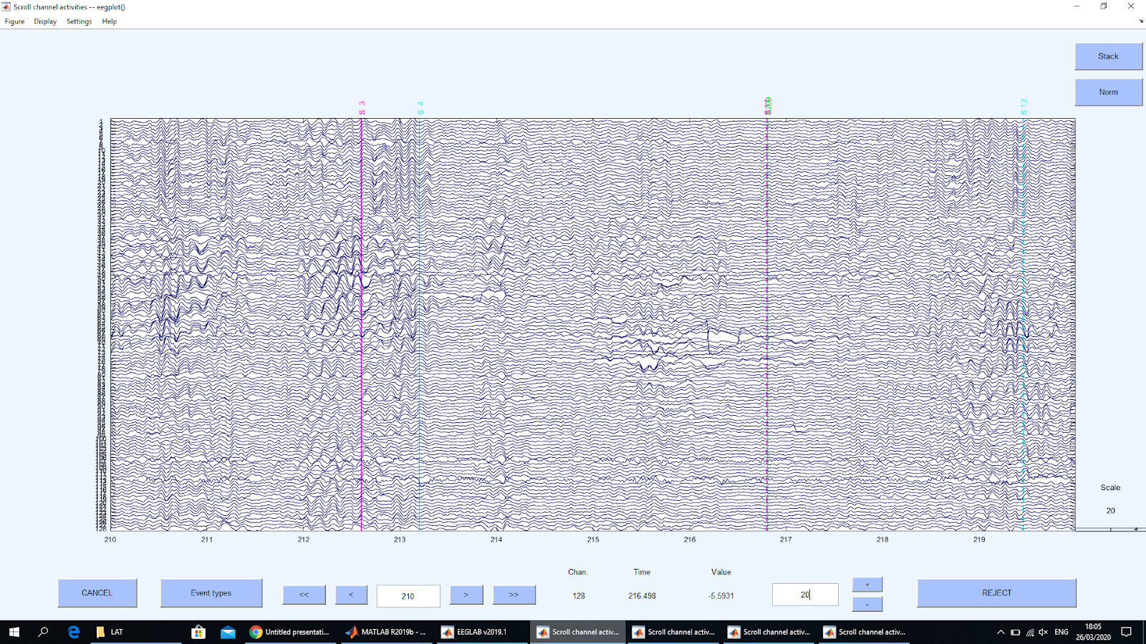
Interpolated

Slide 50
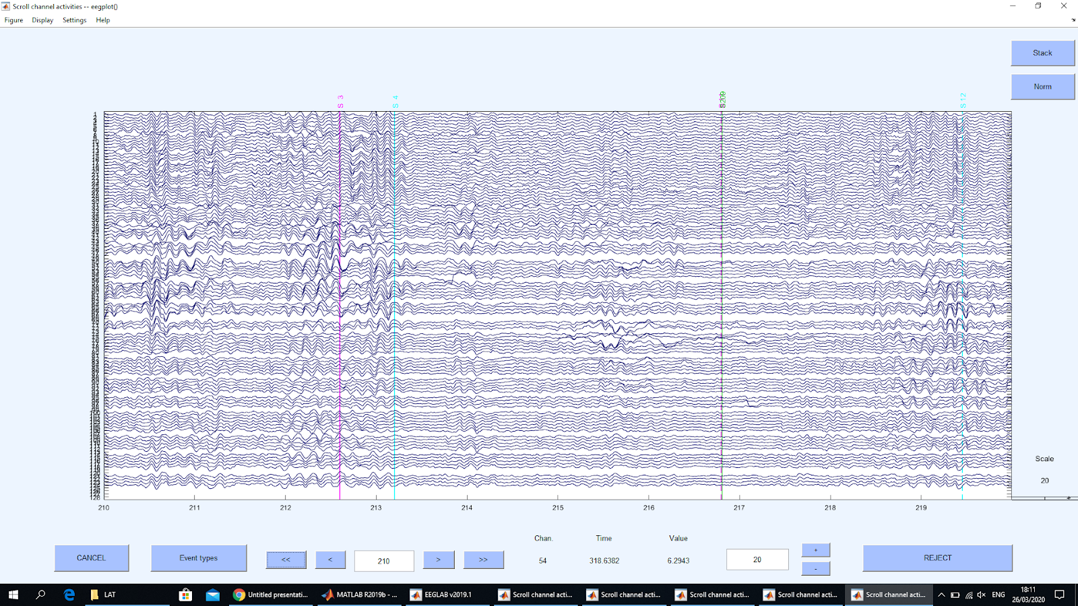
Note: could do better at identifying bad channels
Ignore nonEEG

